Slide 1


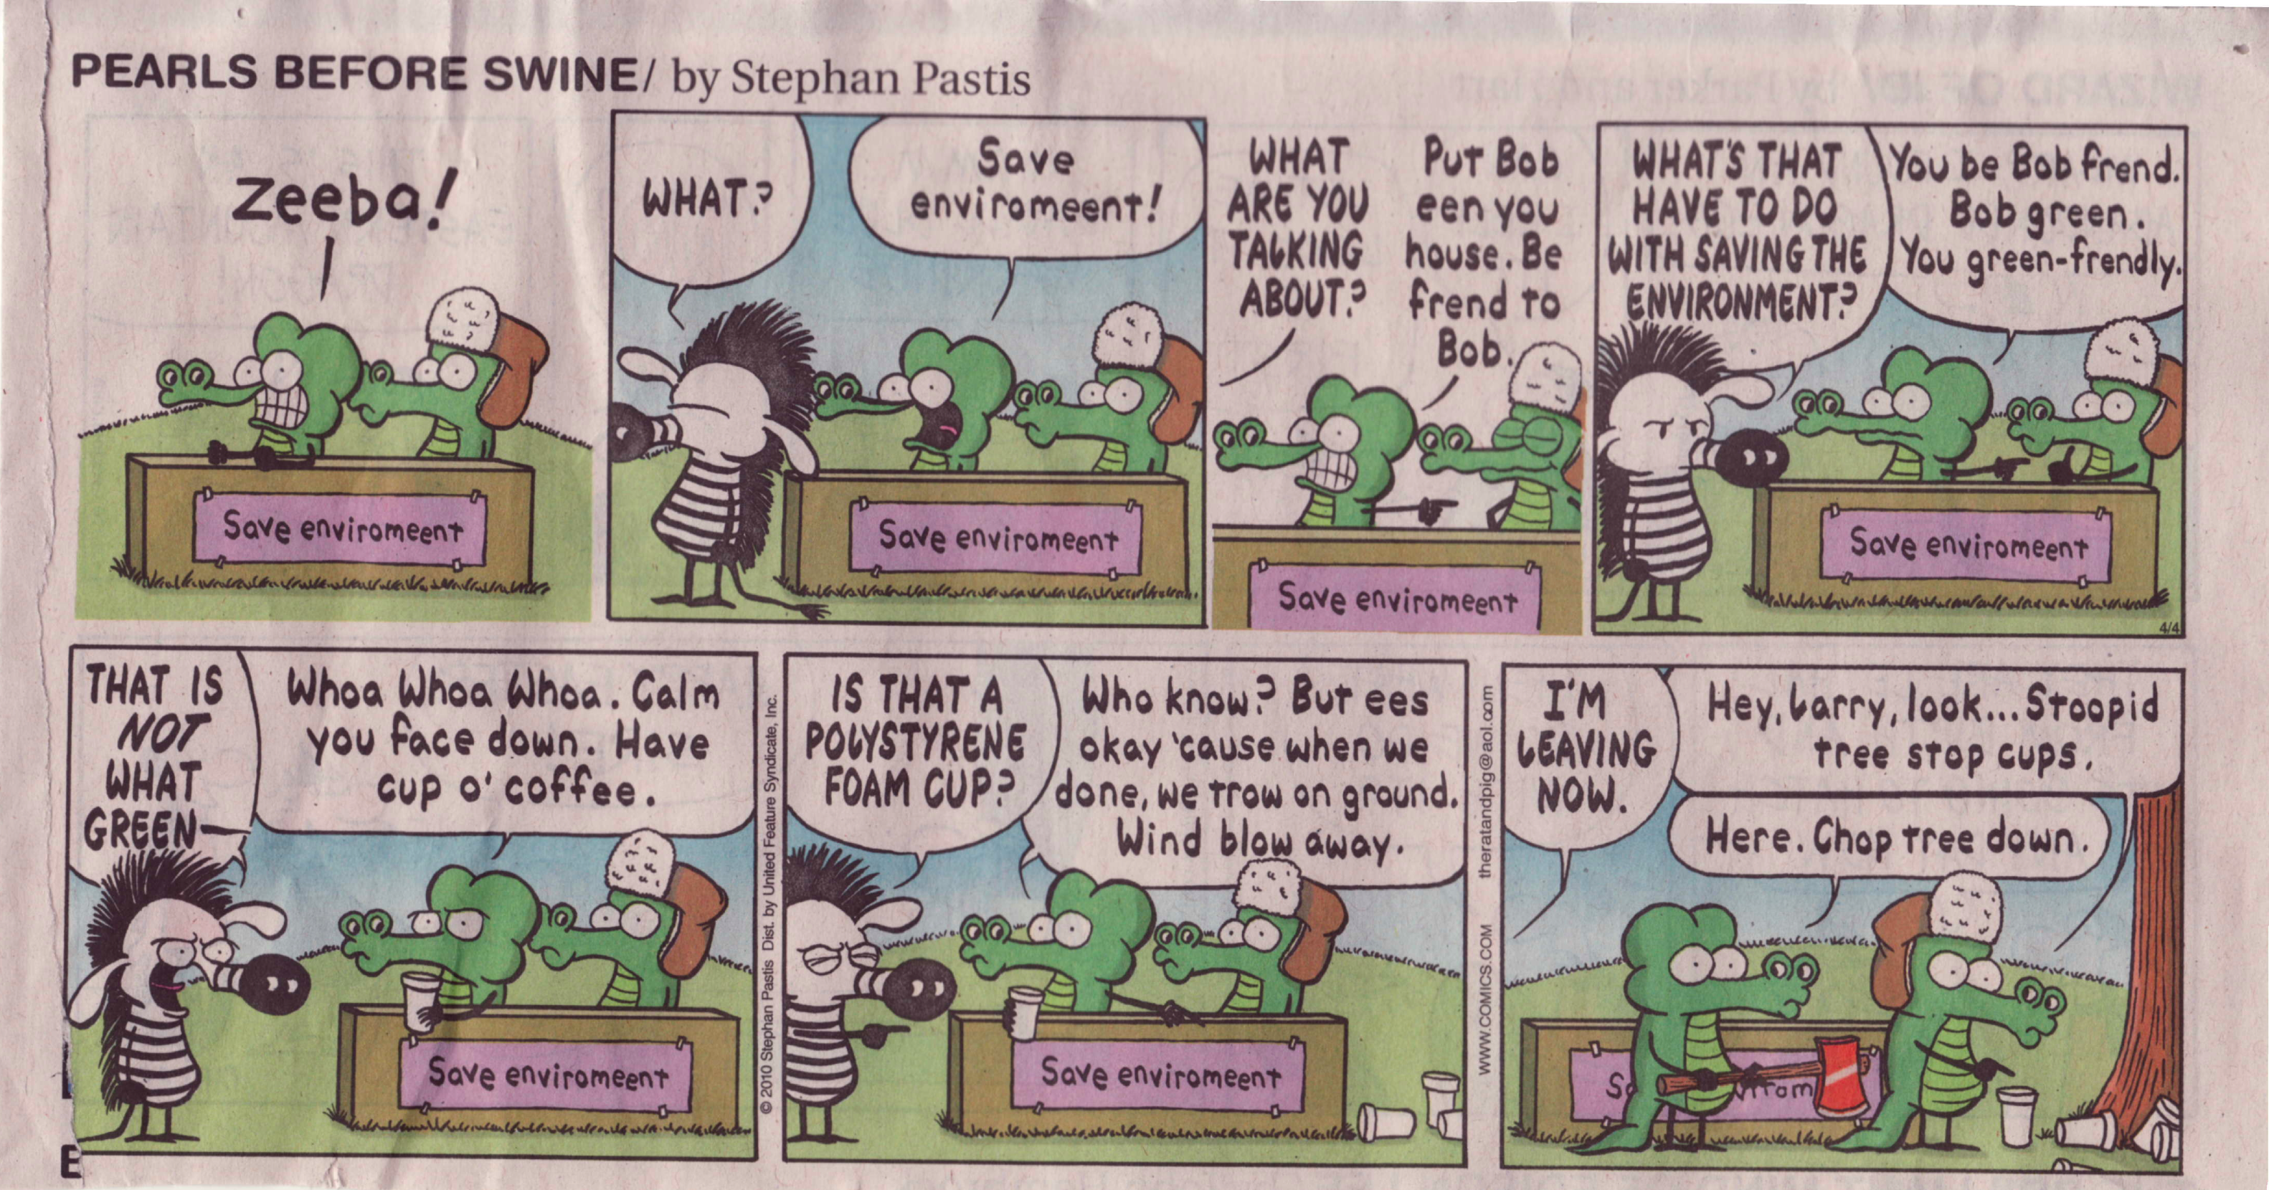
What does “Going Green” Mean?

Slide 2


Sustainability
“To meet the needs of the present without compromising the ability of future generations to meet their own needs.”
– Brundtland Commission, United Nations, 1987
“In every deliberation, we must consider the impact on the seventh generation”
– The Constitution of the Iroquois Nations, ca 1100
Notes:
“Humankind has begun to play dice with the planet, without knowing all the rules of the game.” – McNeil

Slide 3
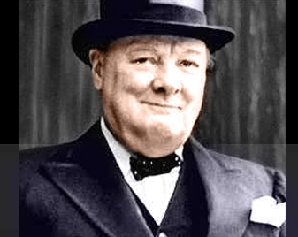
Why Is Sustainability Important?
“The era of procrastination, of half-measures, of soothing and baffling expedients, of delays is coming to its close. In its place we re entering a period of consequences.”
– Winston Churchill
Notes:
“Humankind has begun to play dice with the planet, without knowing all the rules of the game.” – McNeil

Slide 4
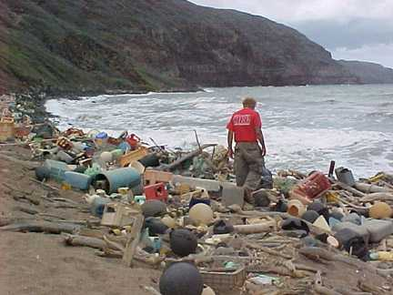
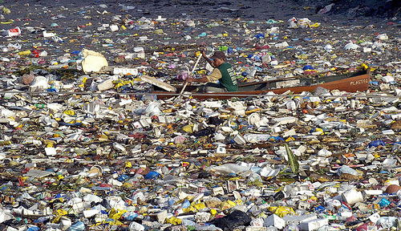

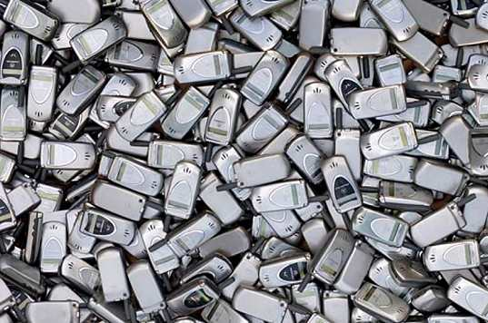
Disposable Society
5.1 billion lbs PET bottles/jars used by US in 2009, 28% recycled
140 million cell phones disposed in US in 2007, 10% recycled
Batteries
Computers

Slide 5
Chemical Exposure & Environmental Contamination
Chapter 3
How are chemicals released into the environment?
What are the impacts on the environment?
  The list of potentially hazardous compounds is large BUT many organic compounds are not harmful
    Volatility (inhalation)
    Solubility (particularly water)
Volatile Organic Compounds (VOCs)
  Solvents, plasticizers, cleaners, air deodorants, paints, smoking, driving
Emissions
  Air, water, and soil pollution

Slide 6

“UNLESS someone like you cares a whole awful lot, nothing is going to get better. It’s not.”
– The Lorax
“Humankind has begun to play dice with the planet, without knowing all the rules of the game.”
– J.R. McNeil
So, what can we do?
Notes:
“Humankind has begun to play dice with the planet, without knowing all the rules of the game.” – McNeil

Slide 7
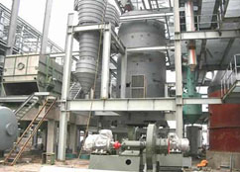
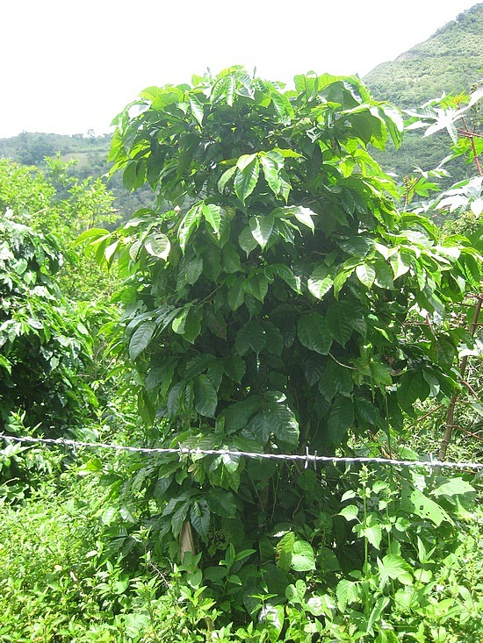
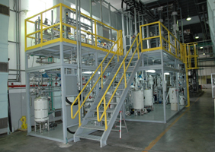
Coffee Decaffeination
Sustainable Innovation is a stepwise process

Slide 8
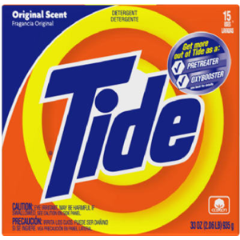
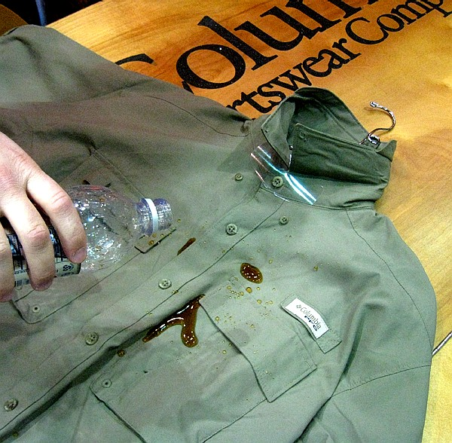
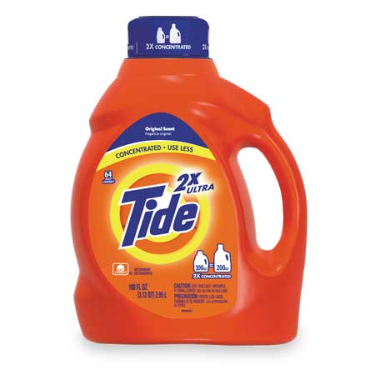
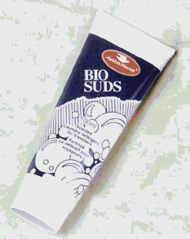
Detergents
Sustainable Innovation is a stepwise process

Slide 9


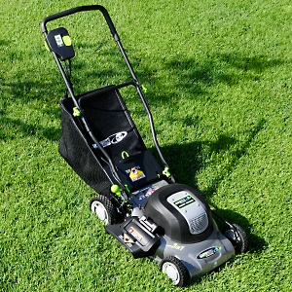
Fuel & Grass
Sustainable Innovation require thinking outside the box

Slide 10

Millau Bridge in France
Sustainable Innovation requires merging technology & nature

Slide 11
Creating a Sustainable Culture
Understand & Be Aware of Environmental Contamination & Chemical Exposure
Traditional vs Green Approaches
Sustainability is a way of thinking
We need to change the culture/mindset
We must educate society in order to stimulate change
Measuring “Greenness”?

Slide 12
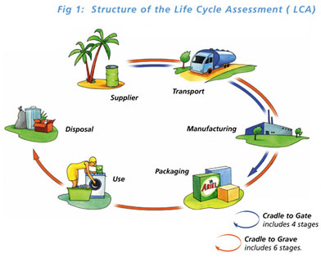
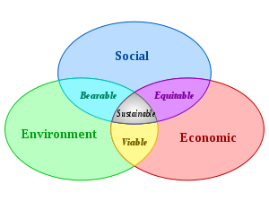
Systems Thinking
“Insanity is doing the same thing over and over again and expecting different results.”
– Albert Einstein
Product vs Production
Sustainability is a mindset

Slide 13
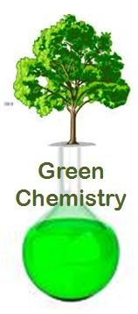
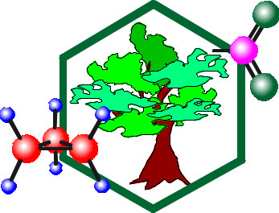
The Role of Green Chemistry
Green Chemistry is a tool for a Sustainable Future
  Incorporation of sustainable thinking in experimental design
We must educate students about GC in a way that encourages application of their knowledge

Slide 14
Introduction to Green Chemistry
Chapter 5
How do we deal with Chemical Exposure?
  Traditional Approaches
    Minimize risk by limiting exposure & reducing quantities used
      “scrubbers”
      Treatment of waste water
      Incineration
      Chemical treatment
      Waste minimization
  Green Chemistry Strategies
    Minimize risk by striving to eliminate or reduce use & generation of hazardous substances
      Risk = f(exposure, hazard)

Slide 15
12 Principles of Green
Chemistry and Engineering
Waste Prevention
Atom Economy
Less Hazardous Chemical Synthesis
Designing Safer Products
Safer Solvents and Auxiliaries
Design for Energy Efficiency
Use of Renewable Feedstocks
Reduce Derivatives
Catalysis
Design for Degradation
Real-time Analysis for Pollution Prevention
Accident Prevention
Prevention Instead of Treatment
Inherent Rather Than Circumstantial
Design for Separation
Maximize Efficiency
Output-Pulled Versus Input-Pushed
Conserve Complexity
Durability Rather Than Immortality
Meet Need, Minimize Excess
Minimize Material Diversity
Integrate Material and Energy Flows
Design for Commercial “Afterlife”
Renewable Rather Than Depleting

Slide 16
The Role of this Class
Green Chemistry Experience VS Green Chemistry Labs
Incorporated labs to teach techniques and green chemistry
  Solventless Aldol
  Acid/Base Extraction
  Biosynthesis of Ethanol
  Friedel-Crafts Acetylation
  Isolation of Spearmint Oil Components
  3-step “green” synthesis where YOU apply previous knowledge
Analyze greenness of current experiments
  Percent Yield, Atom Economy, Atom Efficiency, Effective Mass Yield, E-Factor
Suggest revisions to experiments

Slide 17
Green Chemistry Metrics
Percent (Chemical) Yield
Atom Economy
  How much of the reactants remain in the final product
  Does not account for solvents, reagents, reaction yield, and reactant molar excess
Atom Efficiency

Slide 18
Green Chemistry Metrics (cont)
Effective Mass Yield
  What is benign? Who decides?
  Ignores stoichiometry
E-Factor
  Typically split into 2 sub-categories: organic & aqueous waste
  Smaller is better

