Slide 1
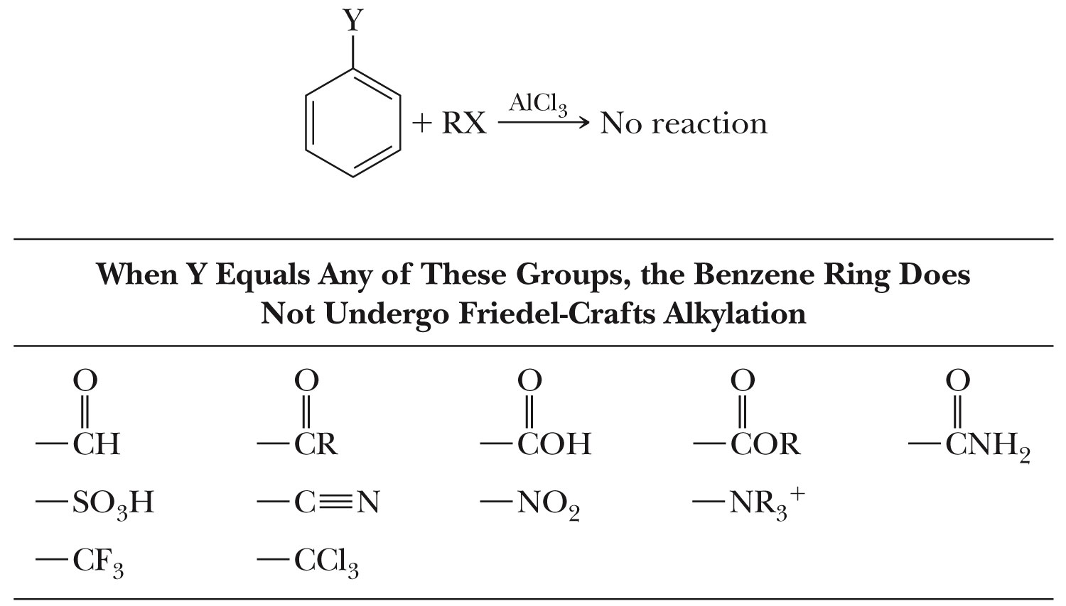
Limitations of Friedel-Crafts Alkylation

Slide 2
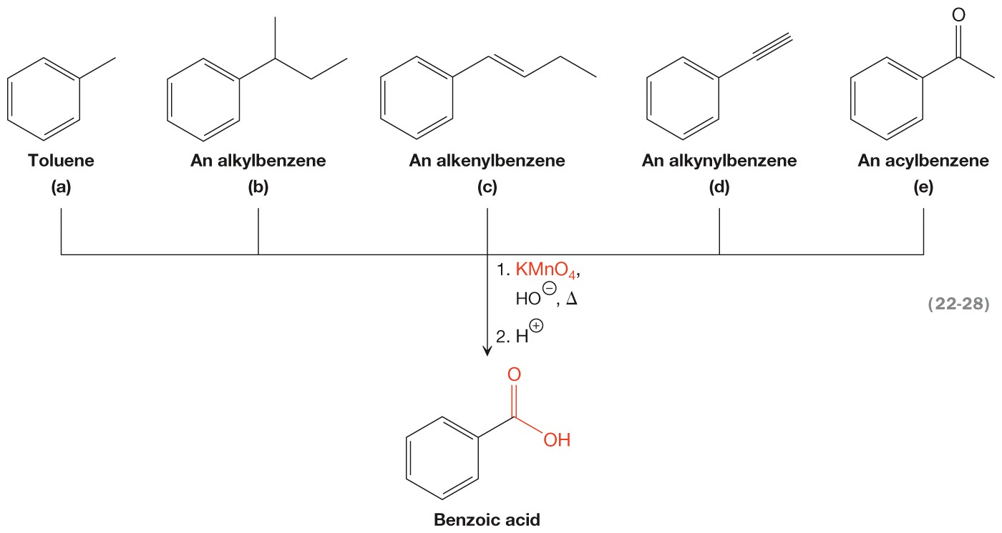
Oxidation of Carbon Side Chains

Slide 3
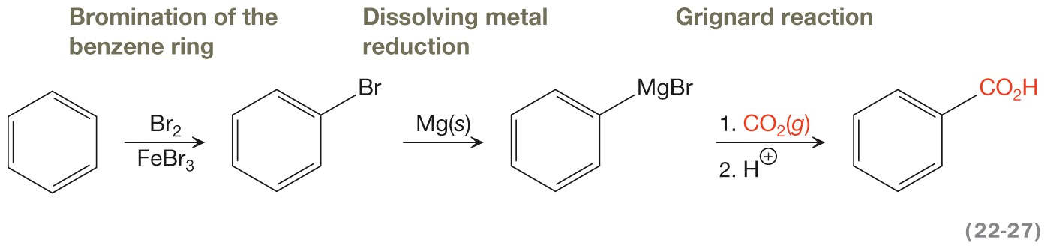
Side Chain Oxidation vs Grignard
Notes:
48_p1086_Karty1_CH22

Slide 4
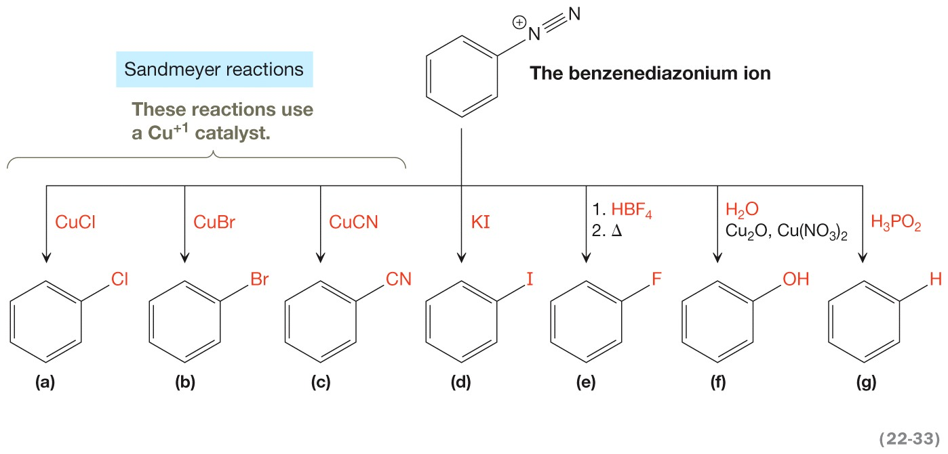
The Sandmeyer Reactions
The reactions require the presence of a Cu⁺ catalyst are, collectively, known as the Sandmeyer reactions.

