Slide 1
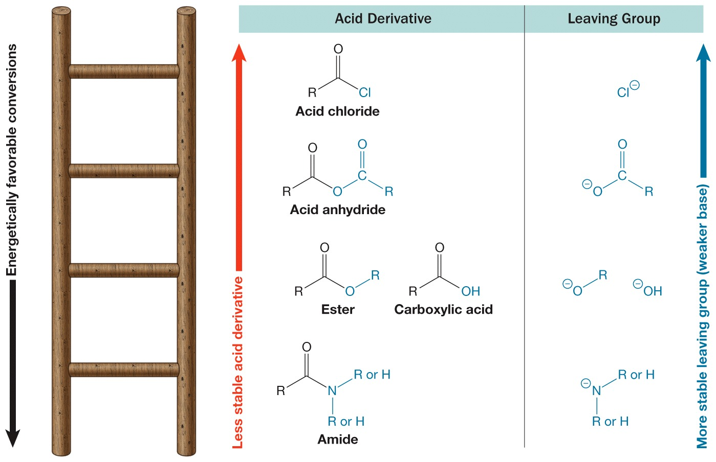
The Stability Ladder

Slide 2
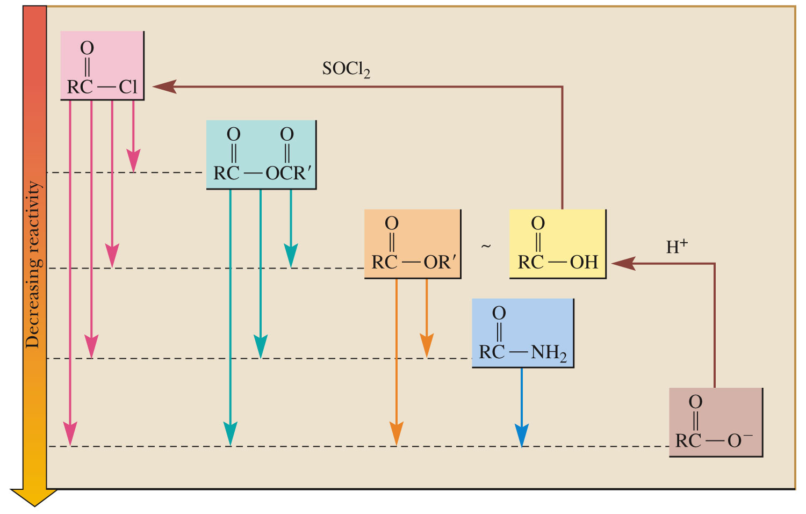
Interconversions

Slide 3
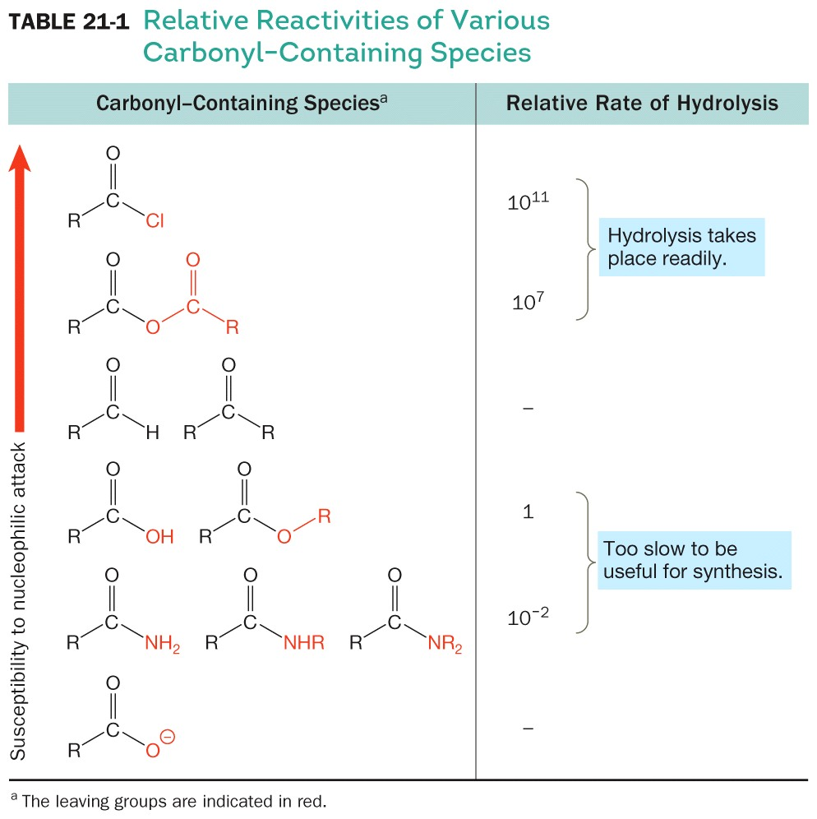
Relative Reactivities of Various Carbonyl-Containing Species

Slide 4
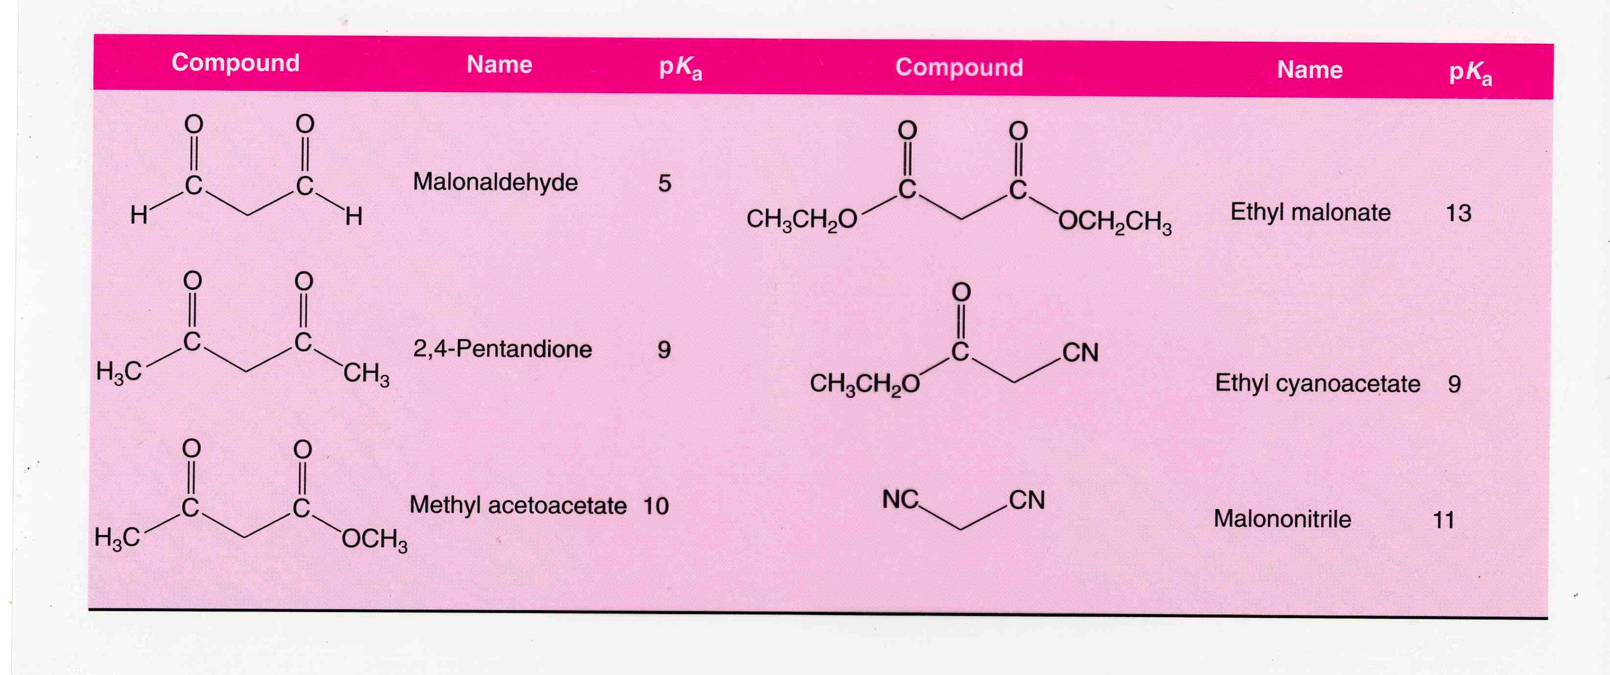
Acidity of Beta-carbonyls

