Slide 1
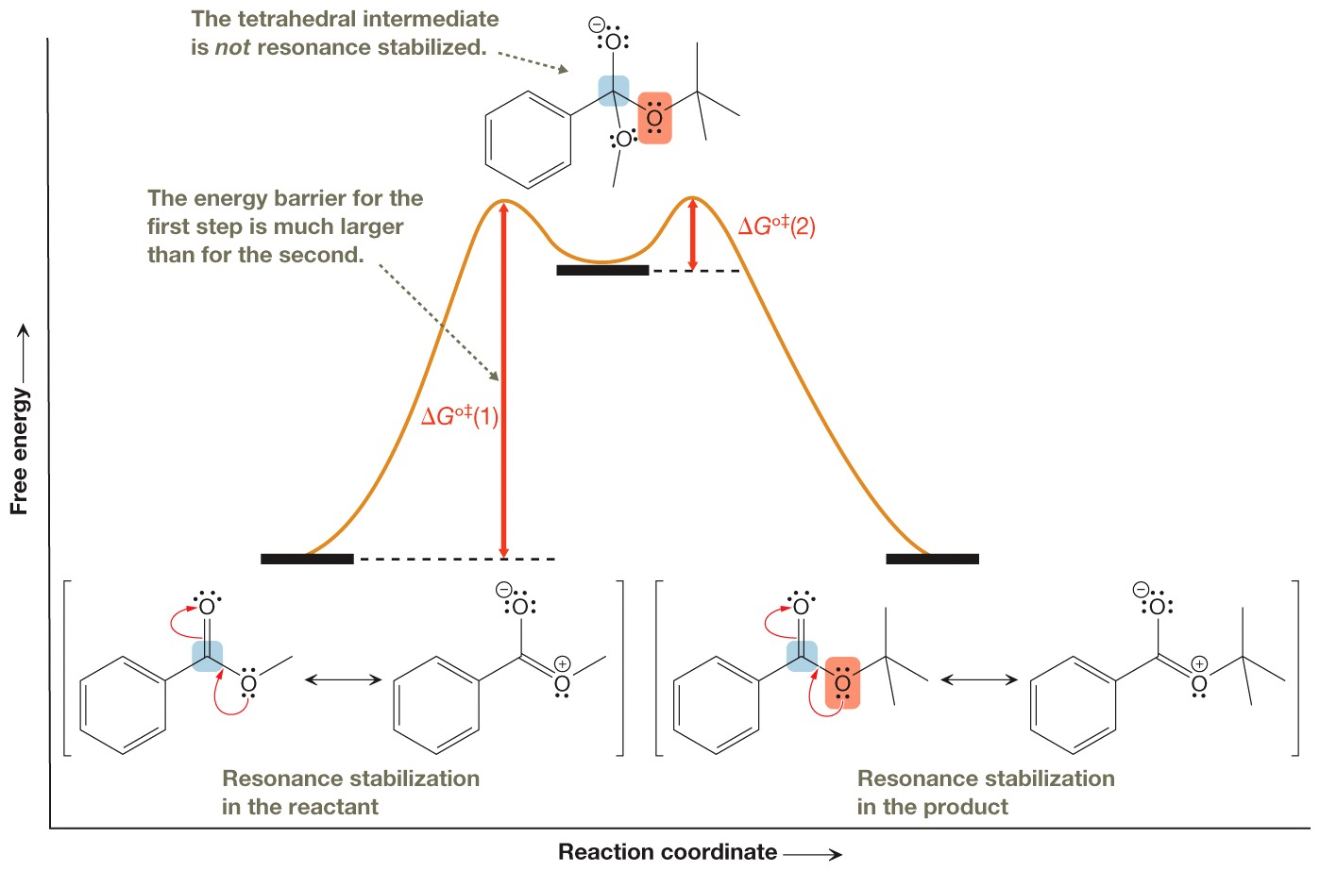
Reaction Diagram for Nucleophilic Addition-Elimination

Slide 2
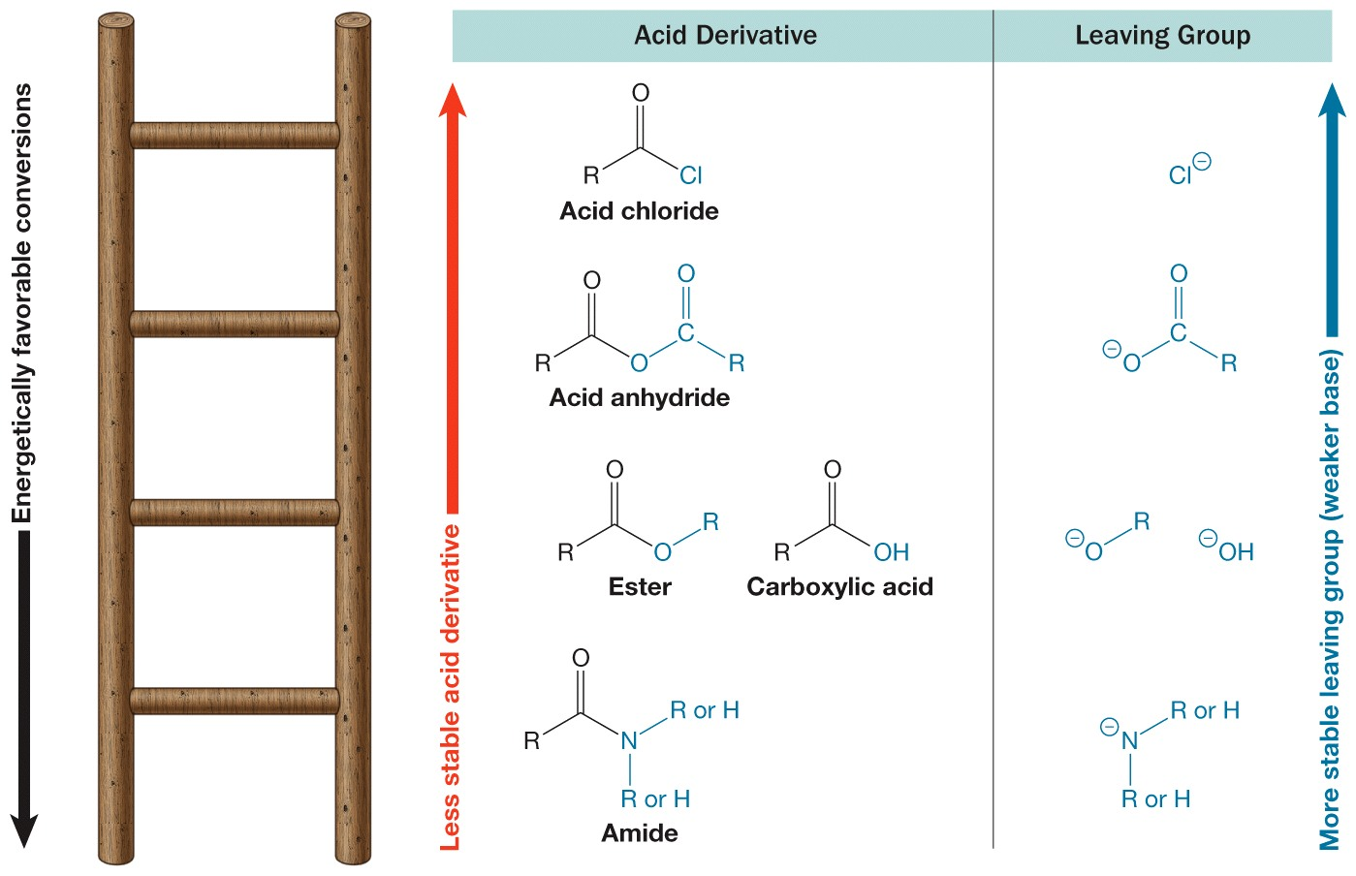
The Stability Ladder

Slide 3
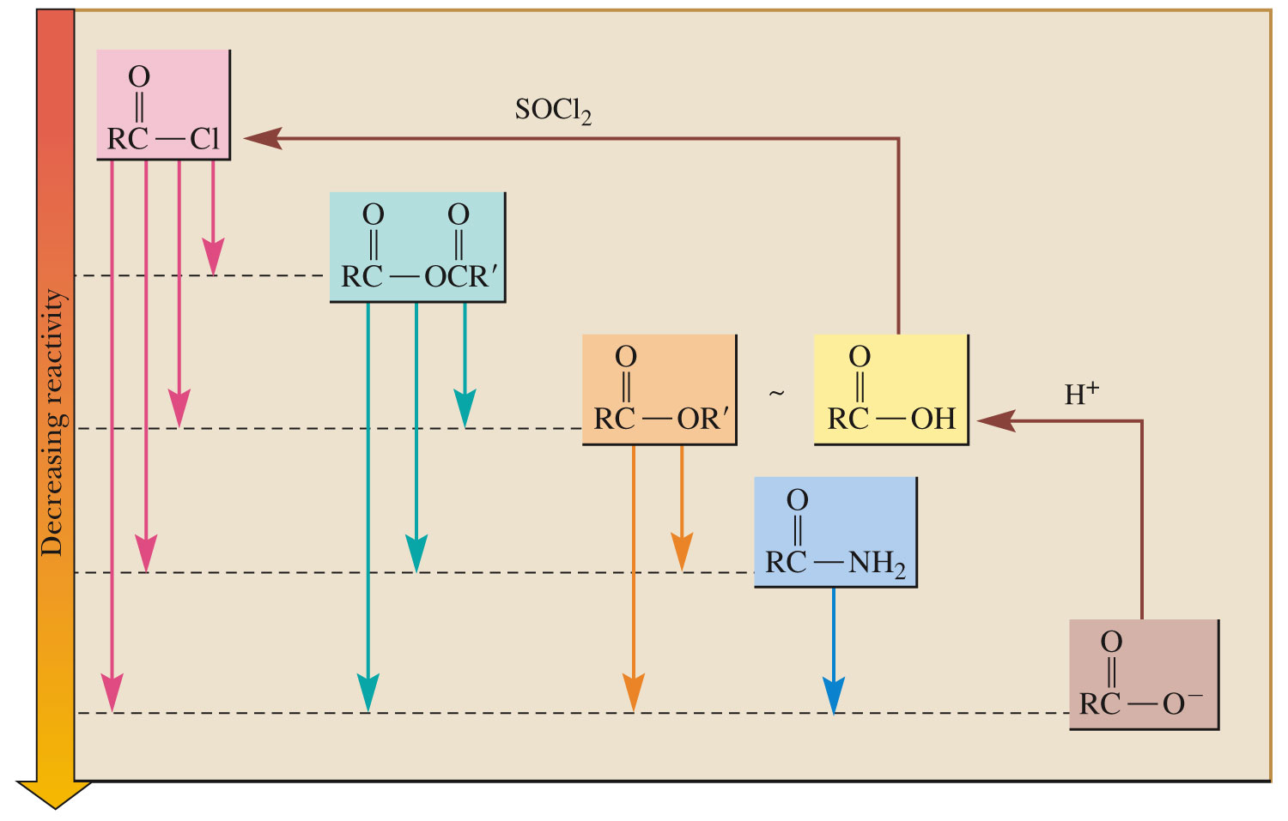

Slide 4
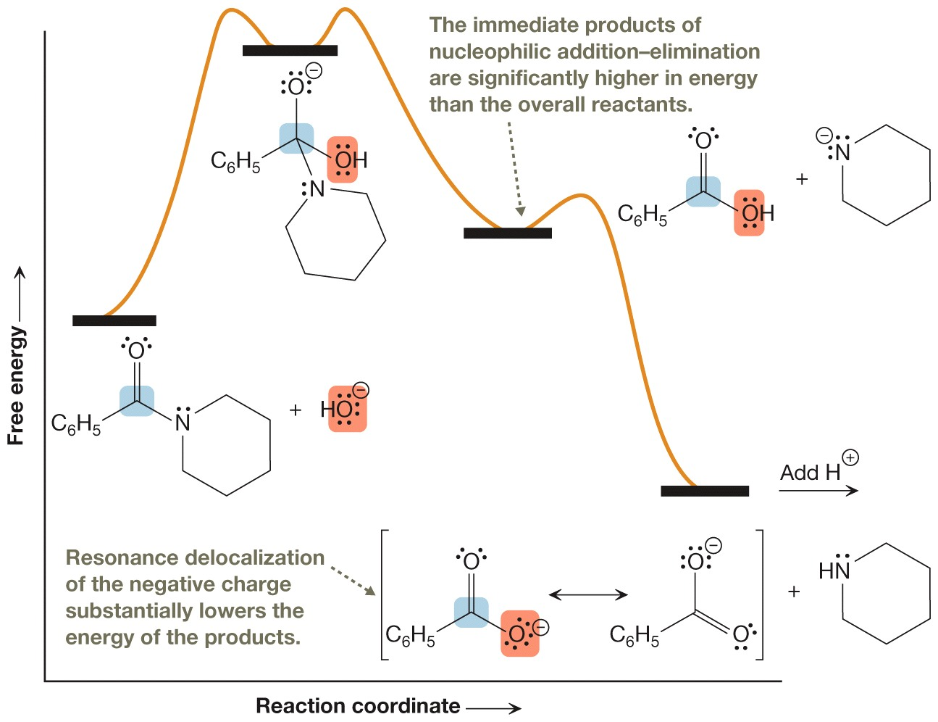
Free-Energy Diagram

Slide 5
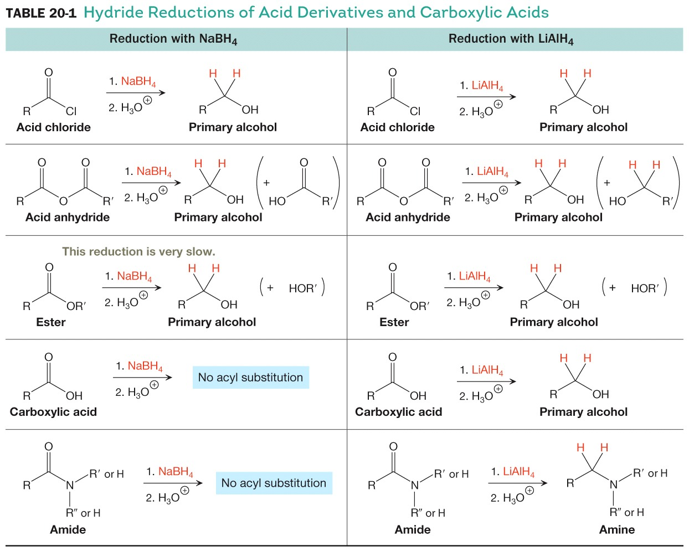
Hydride Reduction of Acid Derivatives

Slide 6
Selective Reduction

