Slide 1
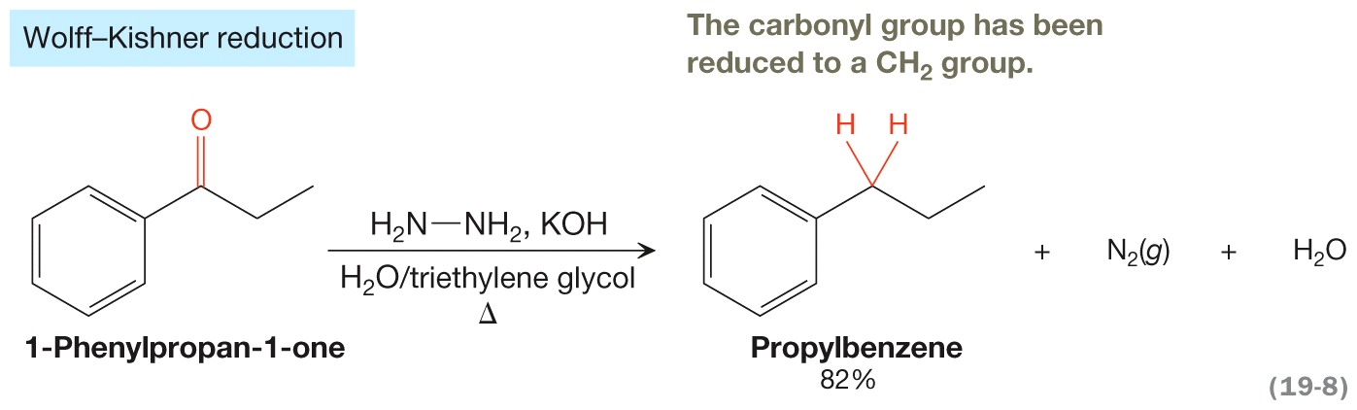
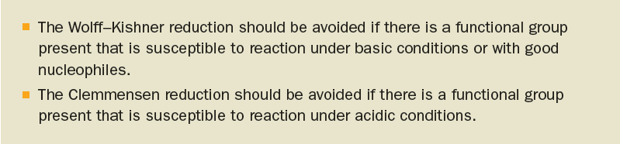
The Wolff–Kishner Reduction

Slide 2
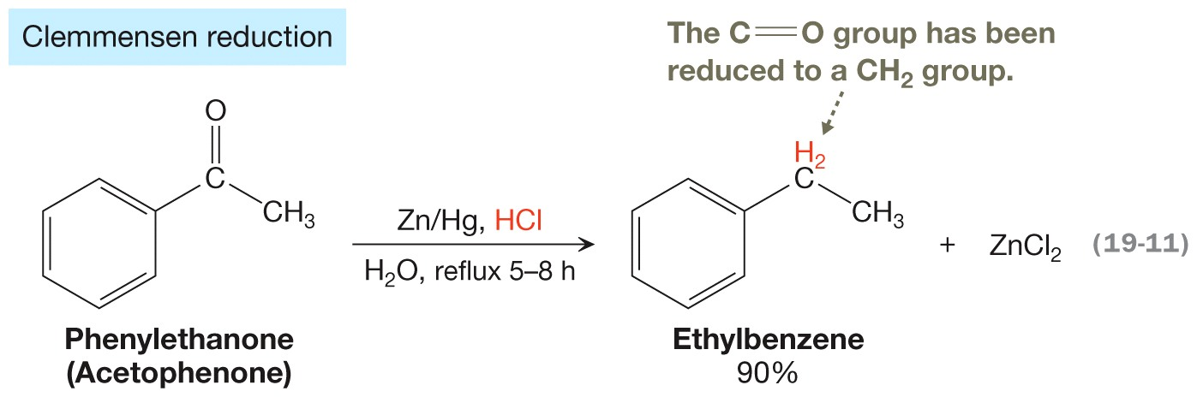
The Clemmensen Reduction

Slide 3
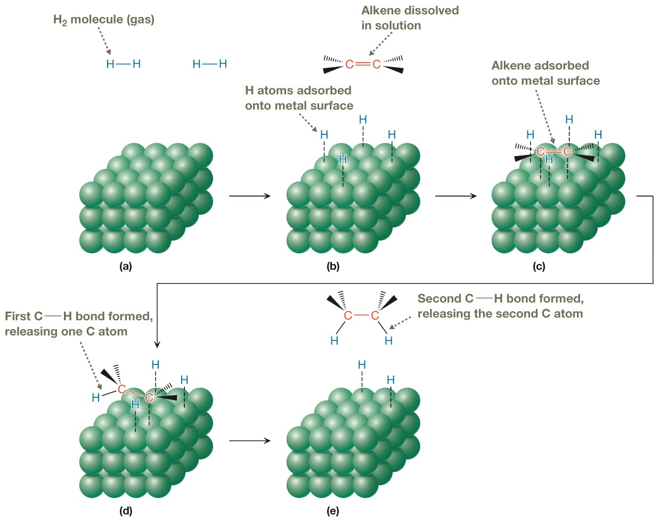
Hydrogenation Mechanism

Slide 4
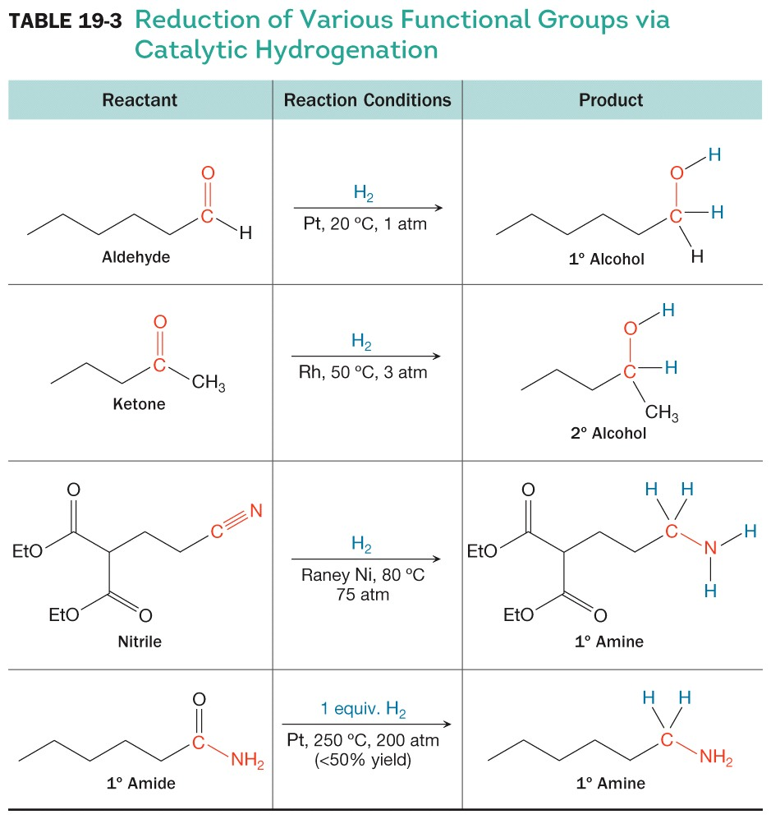
Reduction of Various Functional Groups via Catalytic Hydrogenation

Slide 5
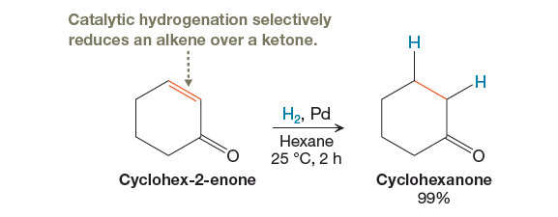
Selectivity in Catalytic Hydrogenation

Slide 6
Oxidation
Green Principles Addressed
  Less Hazardous Reagents
  Safer Solvent
  Waste Prevention
  Energy Efficiency

