Slide 1
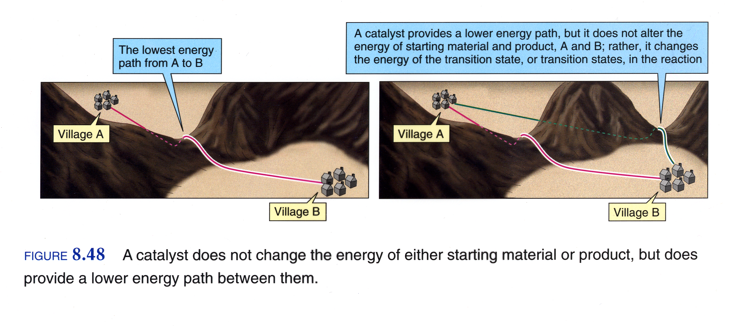
Catalysis

Slide 2
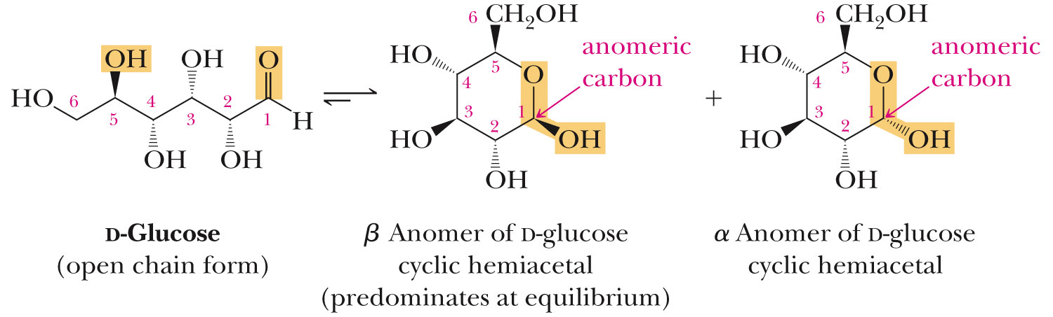
Carbohydrates are Acetals

Slide 3
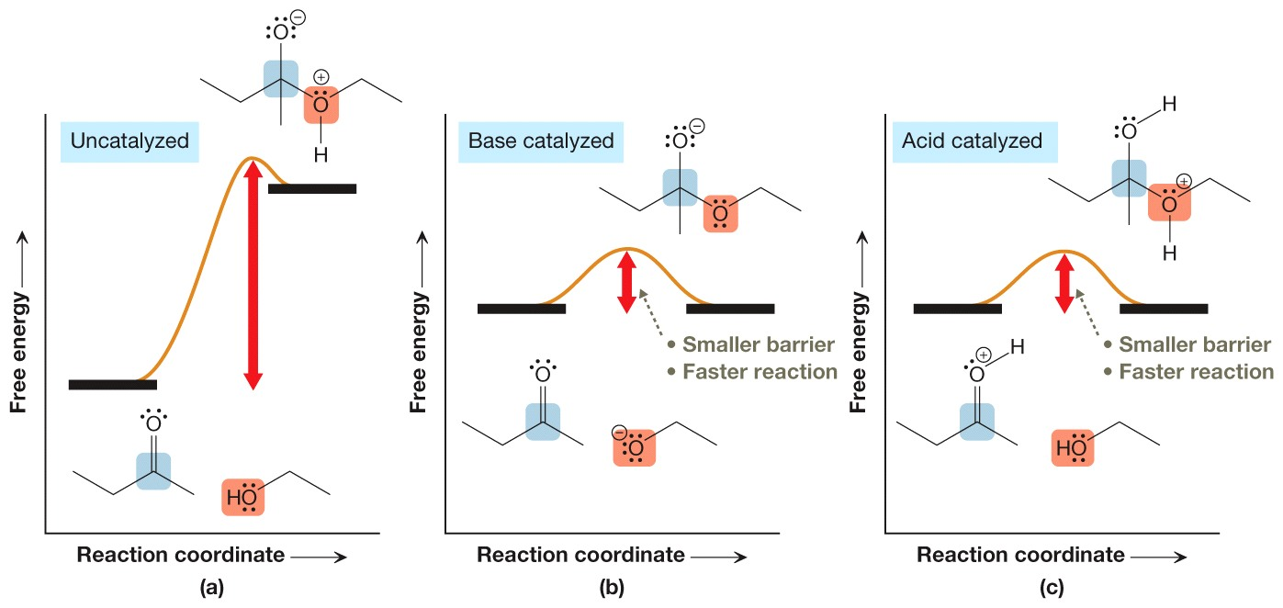
Catalyzed Acetal Formation Energy Diagrams

Slide 4
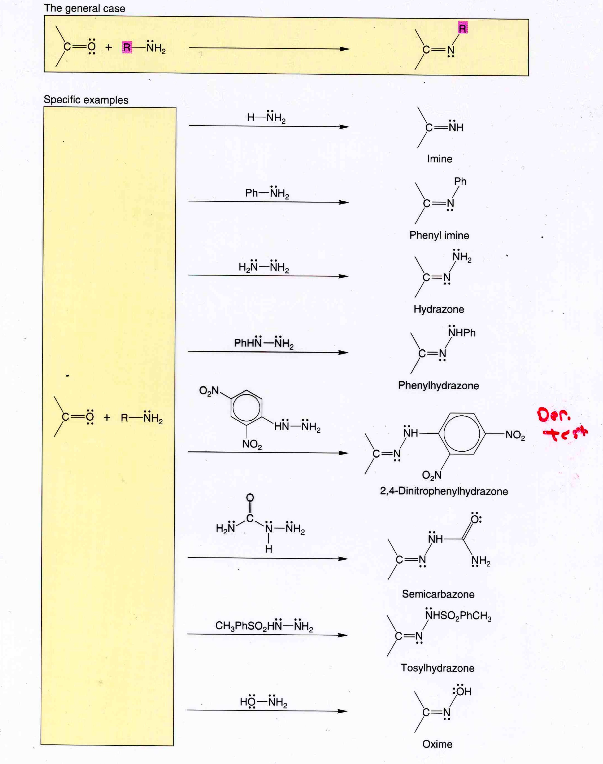
Imines

Slide 5
Greener Aldol Condensation
Green Principles Addresses
  Solventless
  Waste Prevention

Slide 6
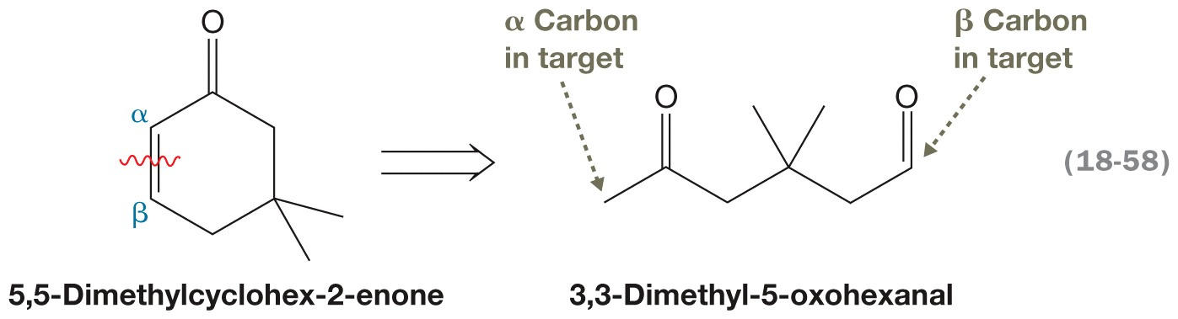
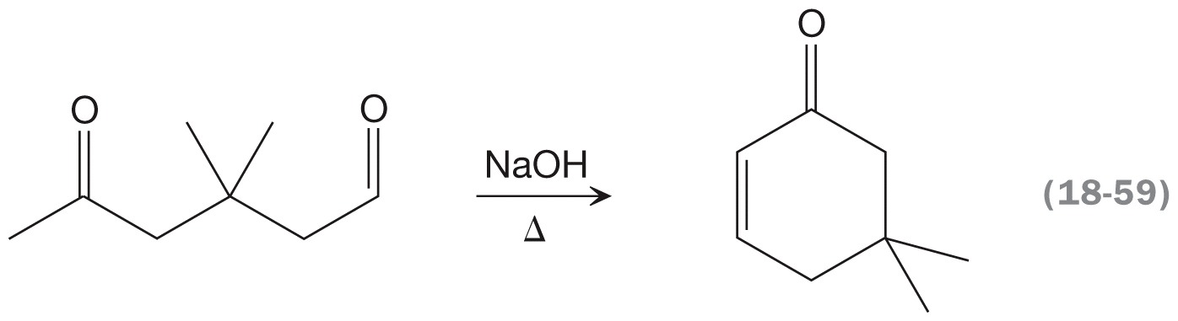
Intramolecular Aldol Condensation in Synthesis
Notes:
83_p898_Karty1_CH18

Slide 7
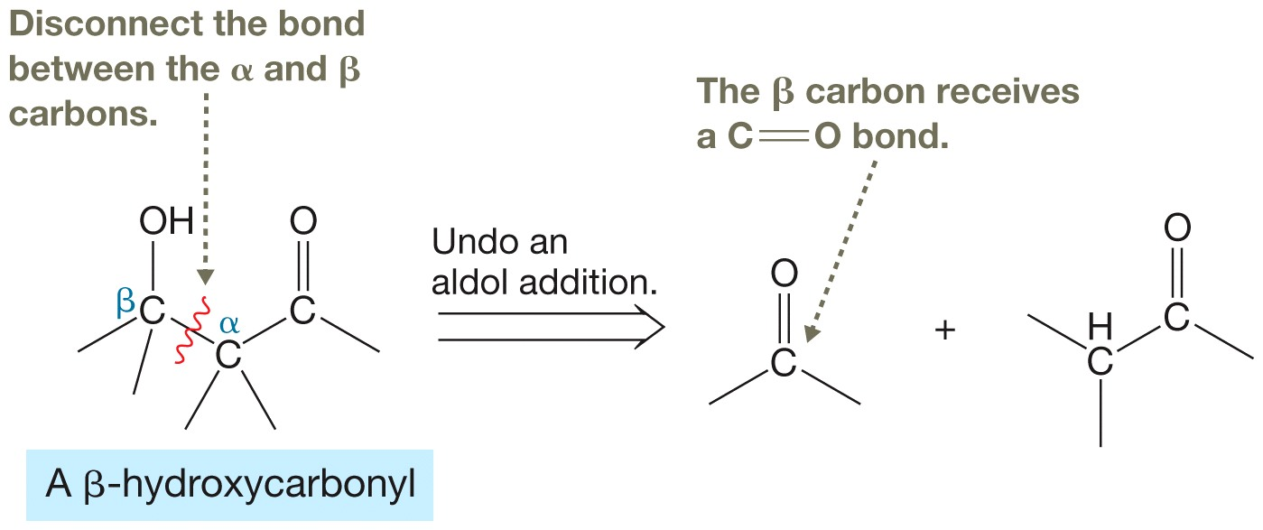
Aldol Addition in Synthesis
Notes:
FIG18.05a_Karty1_CH18

Slide 8
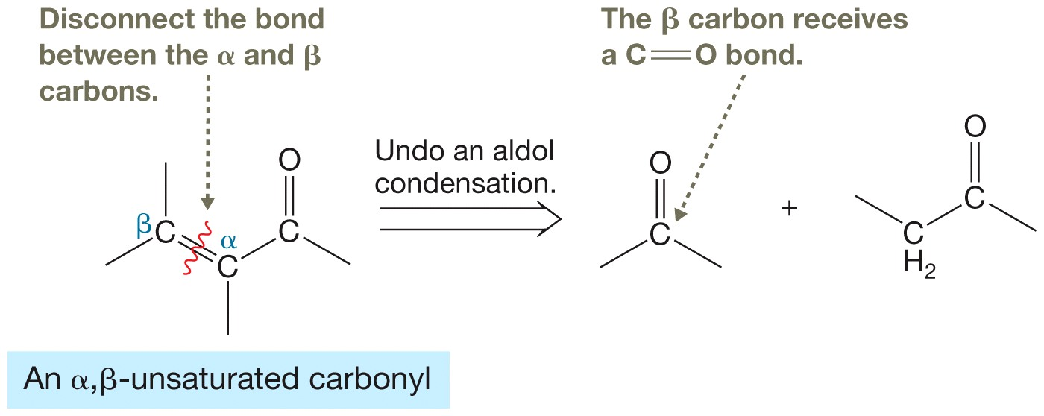
Aldol Condensation in Synthesis
Notes:
FIG18.05b_Karty1_CH18

