Slide 1
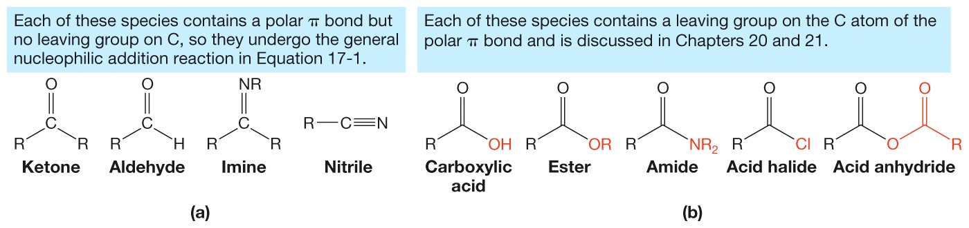
Compounds with Polar π Bonds
In each of these species on the right, however, the C atom of the polar π bond possesses a leaving group.
The presence of a leaving group facilitates another type of reaction with nucleophiles, called nucleophilic addition–elimination reactions.

Slide 2
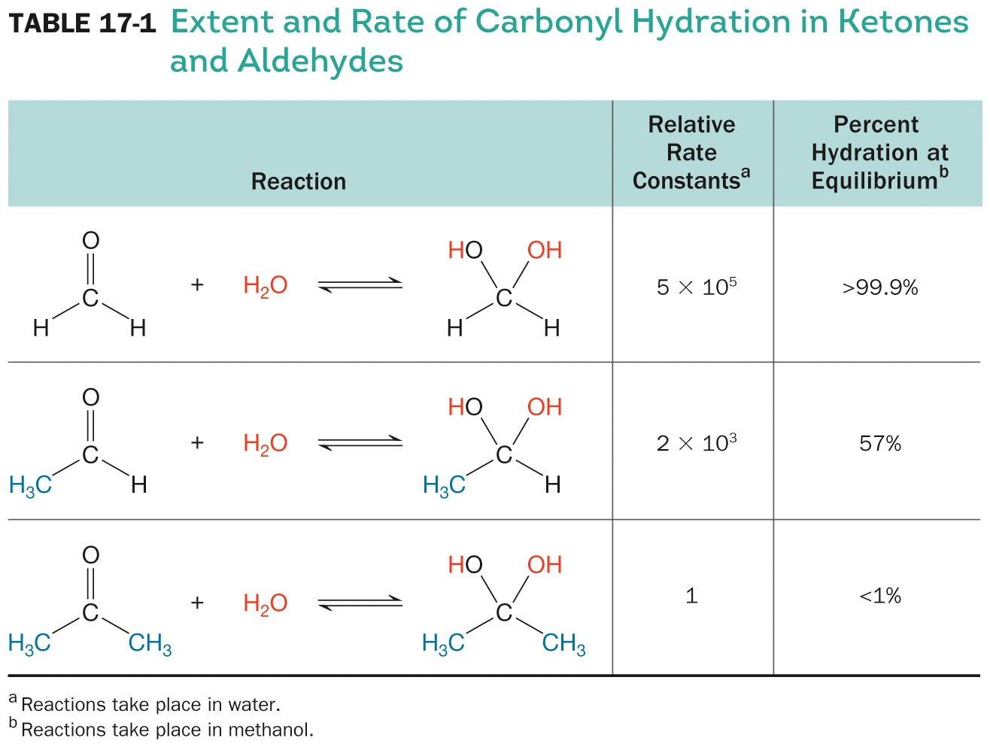
Hydration Rate and Equilibrium Constants

Slide 3
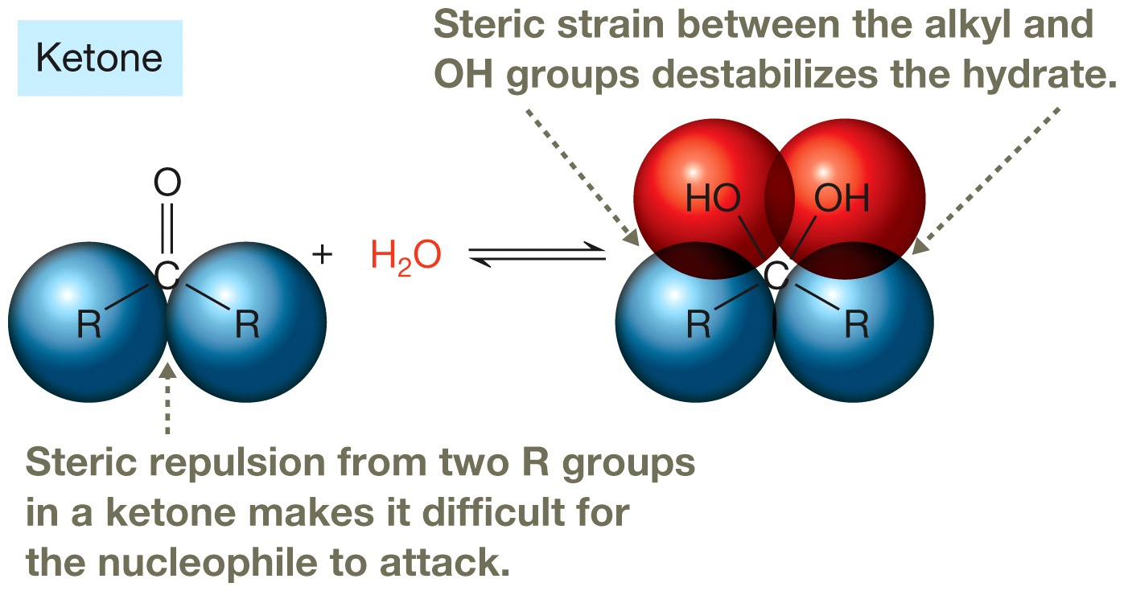
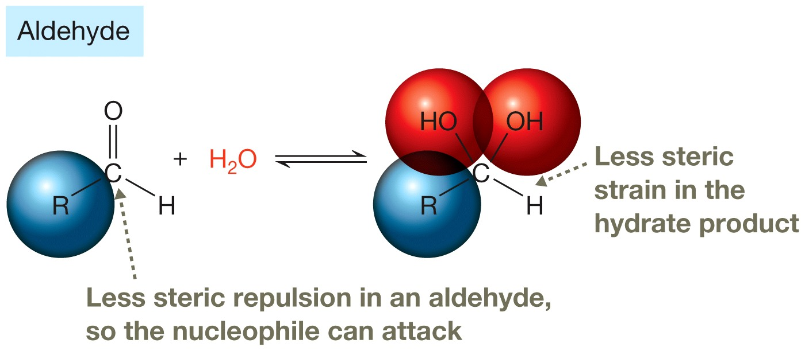
Structural Comparison

Slide 4
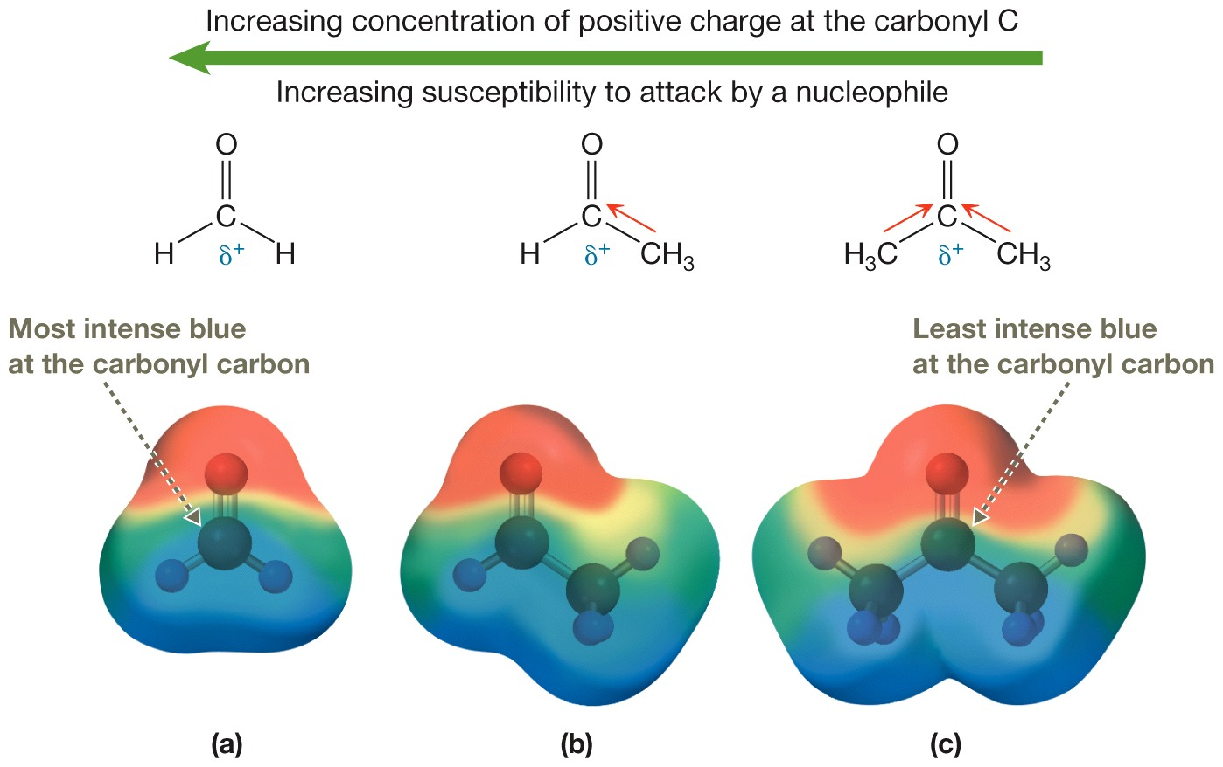
Inductive Effects

Slide 5
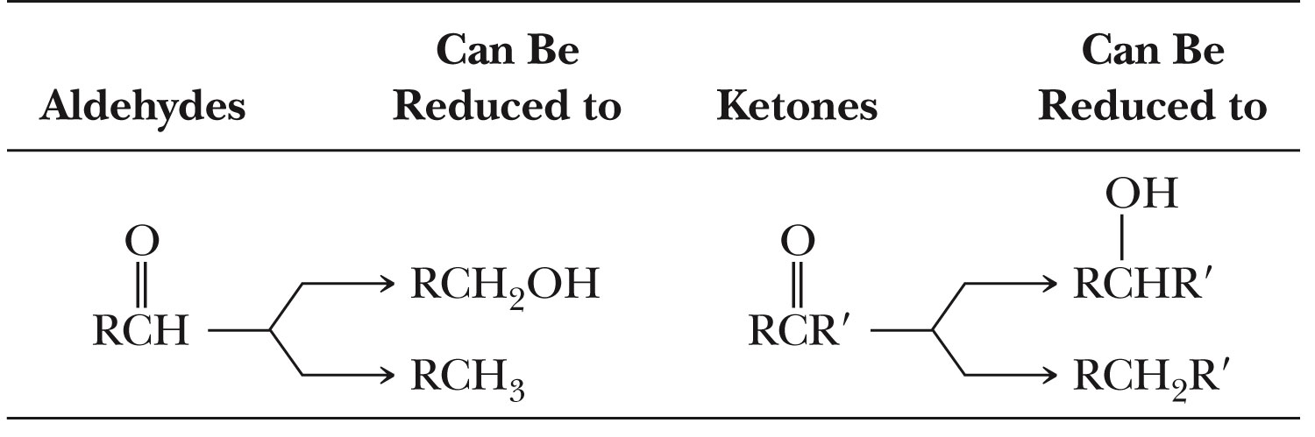
Reduction
p. 617

Slide 6
Reduction
Green Principles Addresses
  Less Hazardous Reagents
  Safer Solvent
  Use of Renewable Feedstocks
  Catalysis

Slide 7
Selective Reduction

Slide 8
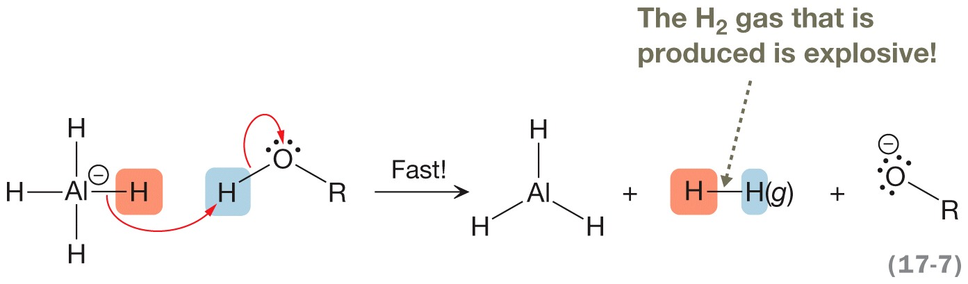
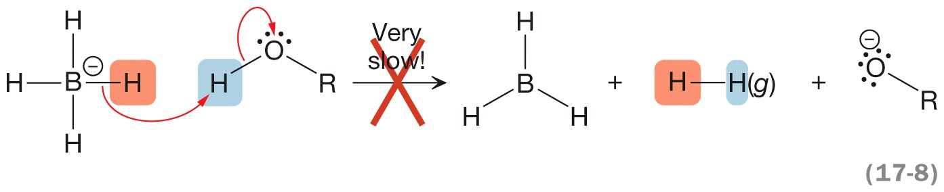
LiAlH₄ and NaBH₄ Reactivity with a Proton Source

Slide 9
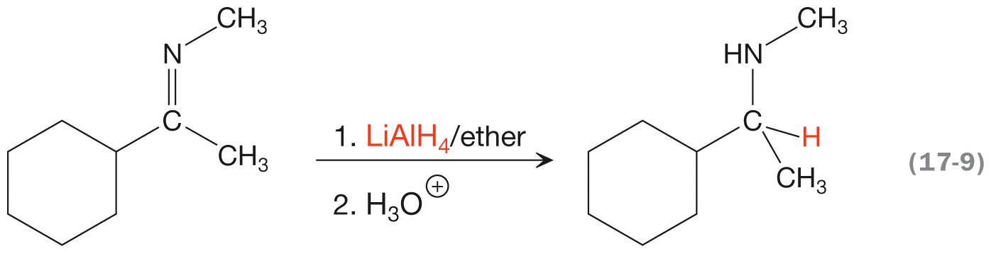
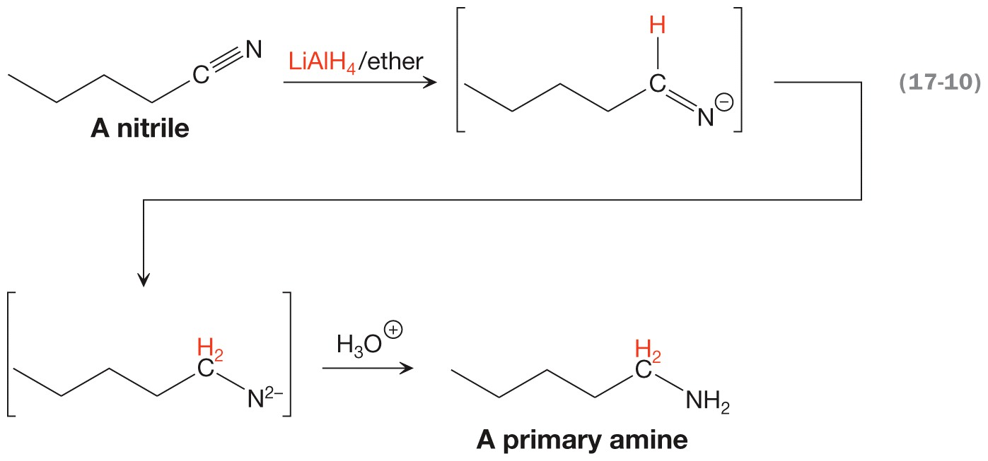
Reduction of Other Functional Groups
LiAlH₄ must be used for both reductions

Slide 10
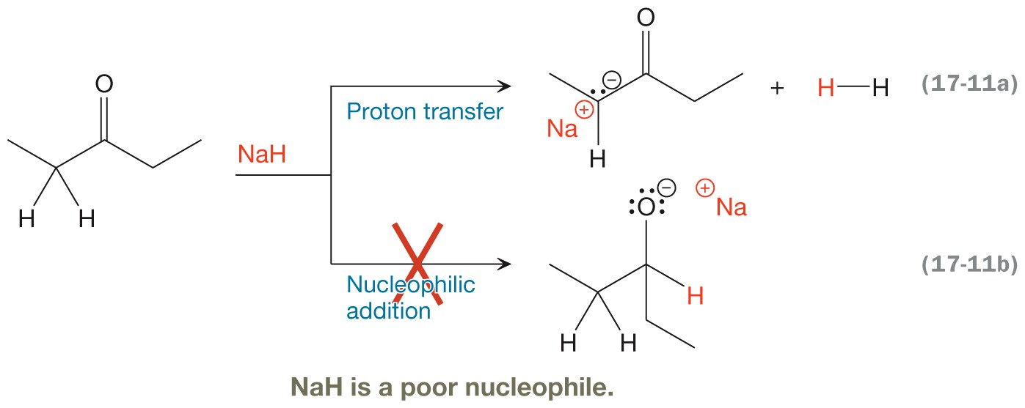
Sodium Hydride

Slide 11
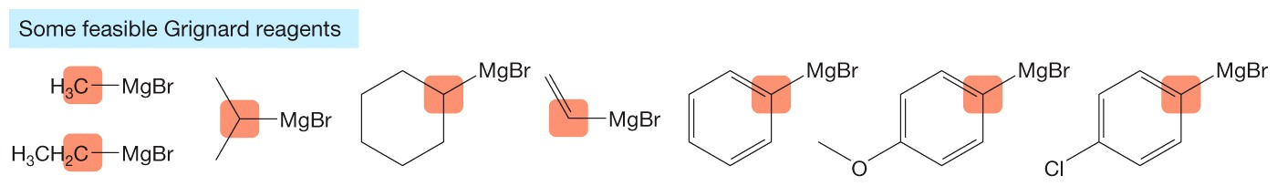
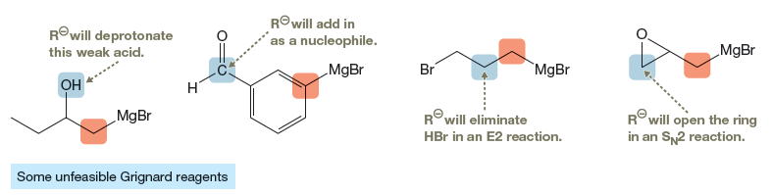
Some Feasible Grignard Reagents
A Grignard reagent should not contain functional groups that react with strong bases or strong nucleophiles.
The Grignard reagents below are unfeasible.

Slide 12
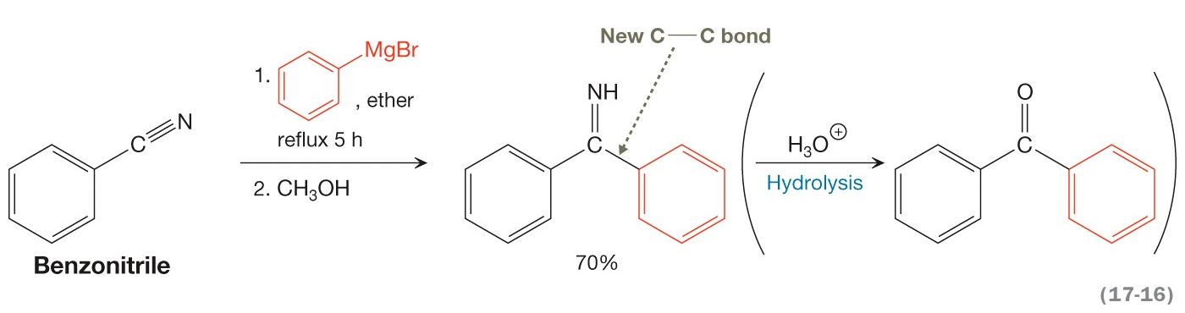
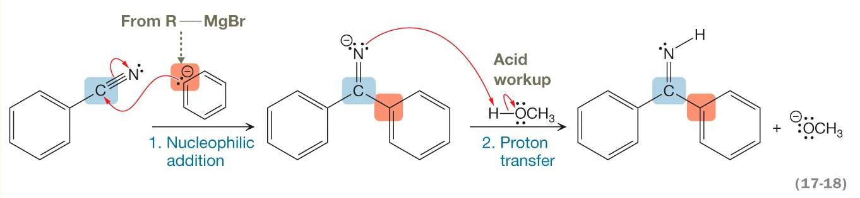
Grignard Reaction and Mechanism

Slide 13
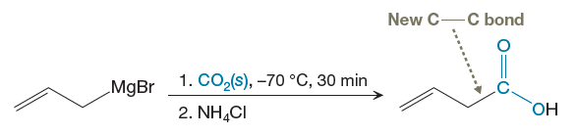
Grignard Reactions Can Be Used to Produce Carboxylic acids

Slide 14
Wittig
Green Principles Addresses
  Less Hazardous Reagents
  Safer Solvent
  Energy Efficiency

Slide 15
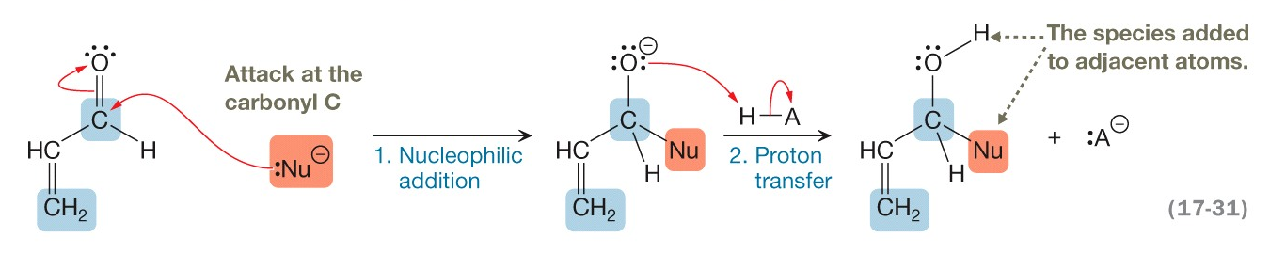
Direct 1,2-Addition Mechanism

Slide 16
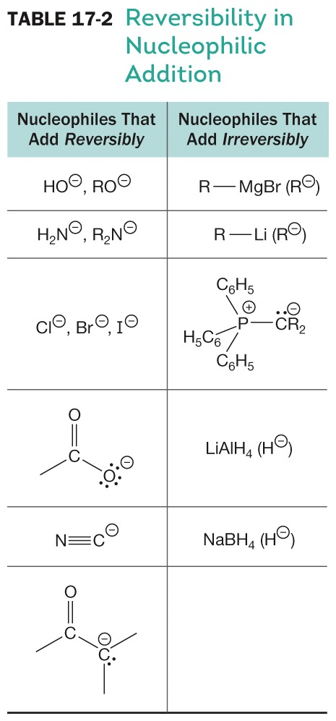
Reversibility in Nucleophilic Addition

Slide 17
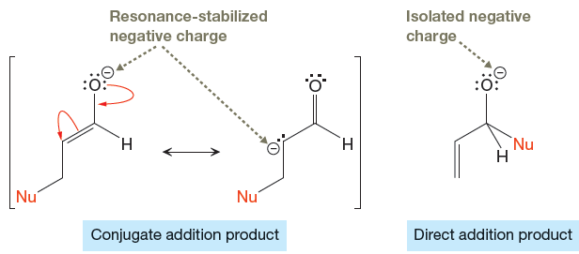
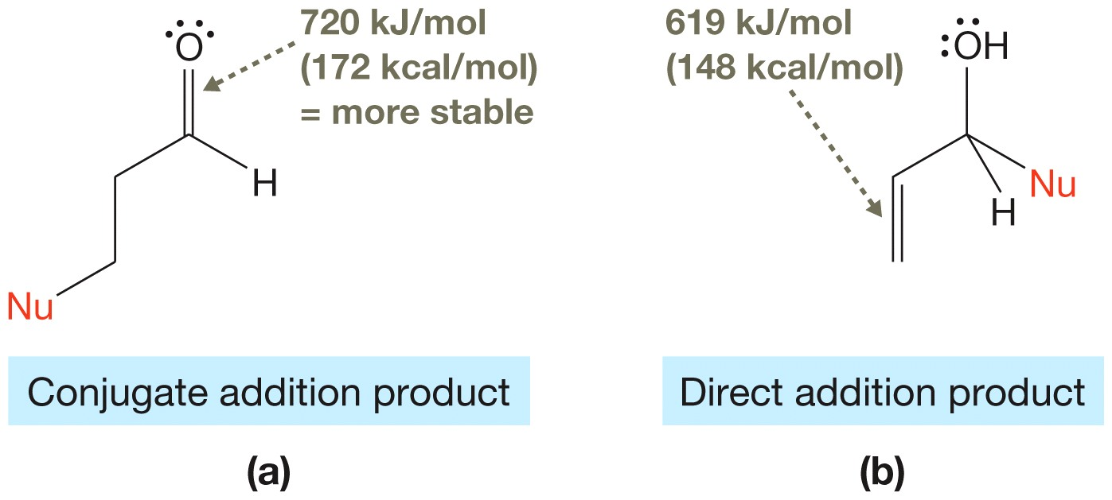
Thermodynamic Product

Slide 18
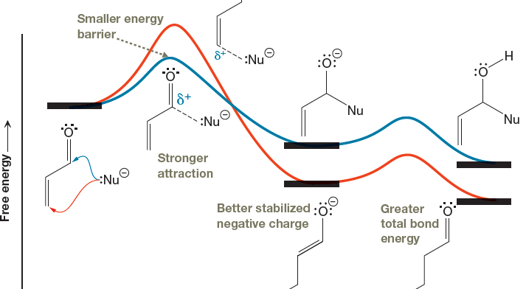
Thermodynamic or Kinetic Product?

Slide 19
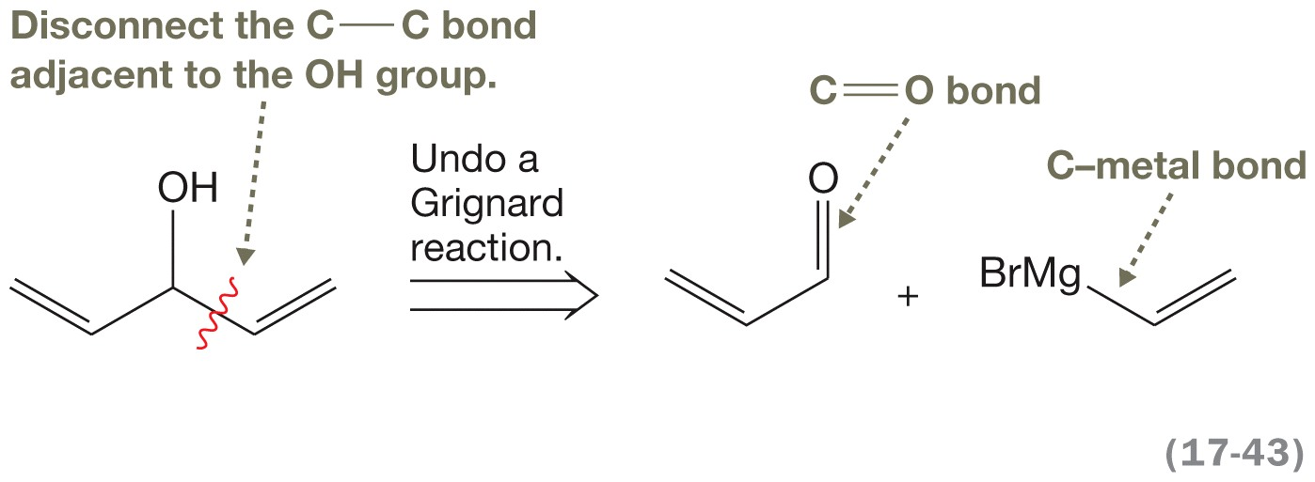
Organometallics in Synthesis
Notes:
66_p847_Karty1_CH17

Slide 20
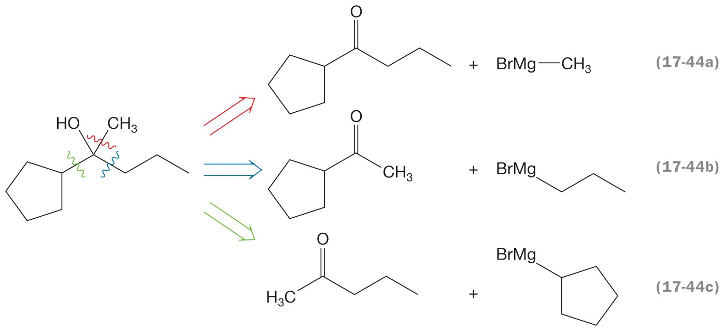
Organometallics in Synthesis
Notes:
67_p847_Karty1_CH17

Slide 21
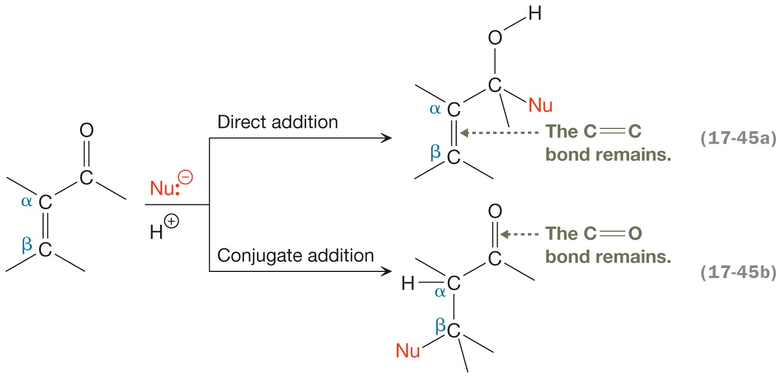
Synthesis and Direct/Conjugate Addition
Notes:
68_p848_Karty1_CH17

Slide 22
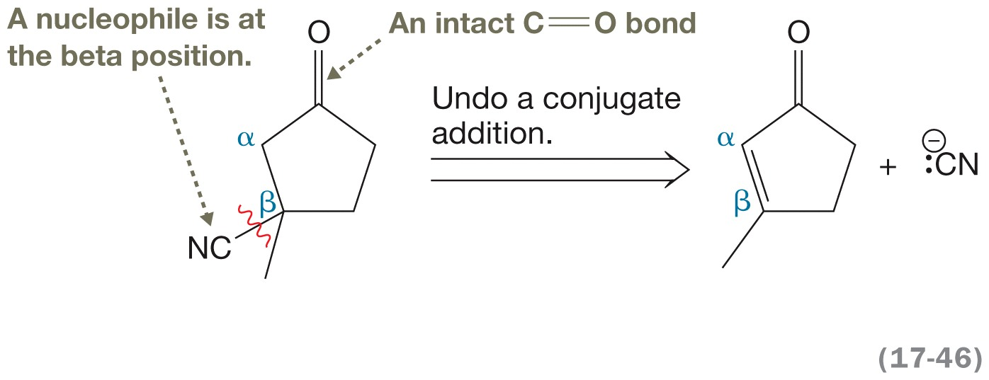
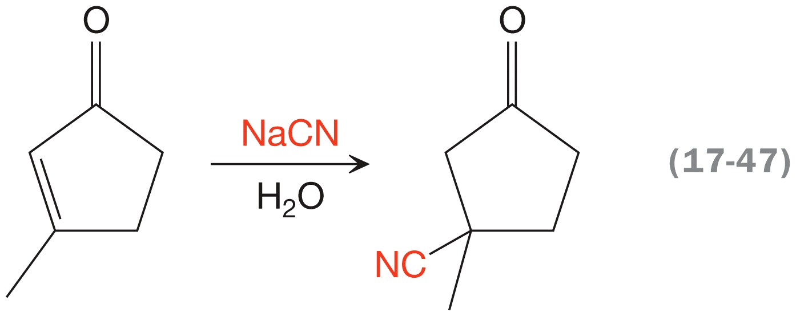
Synthesis and Direct/Conjugate Addition
Notes:
69_p848_Karty1_CH17

Slide 23
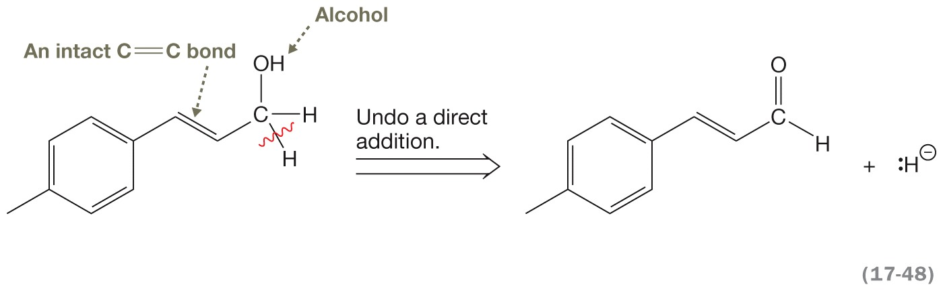
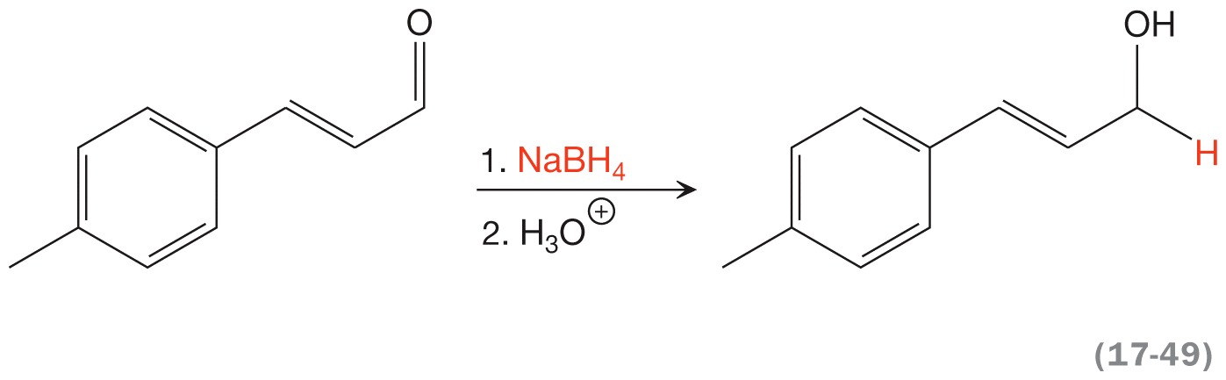
Synthesis and Direct/Conjugate Addition
Notes:
71_p849_Karty1_CH17

Slide 24
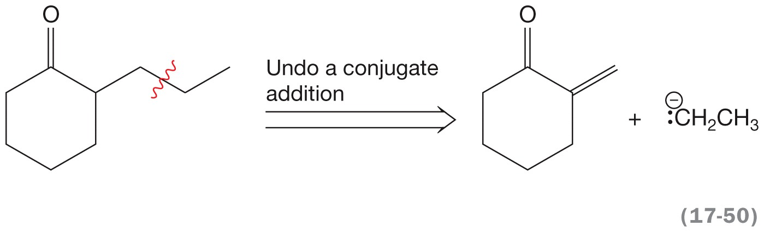
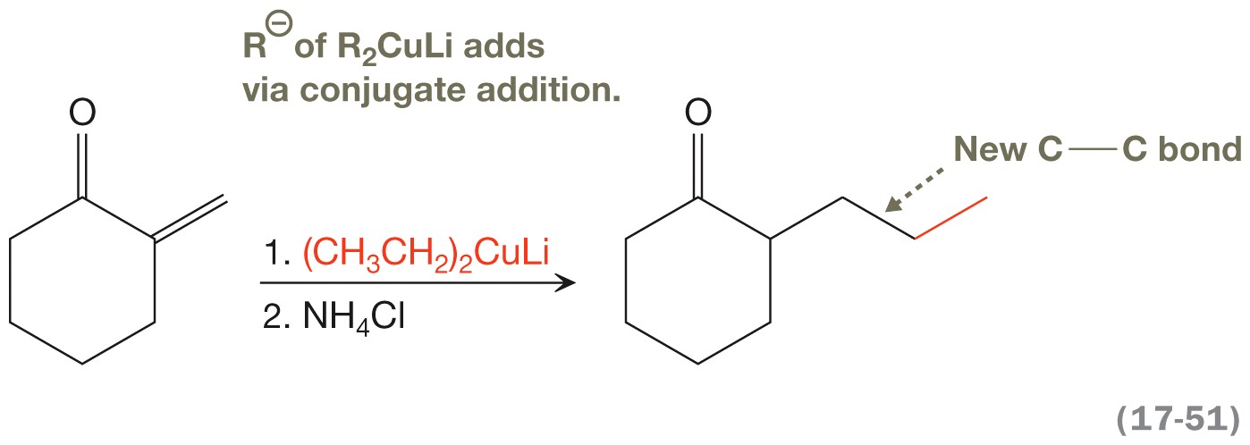
Synthesis and Direct/Conjugate Addition
Notes:
73_p849_Karty1_CH17

Slide 25
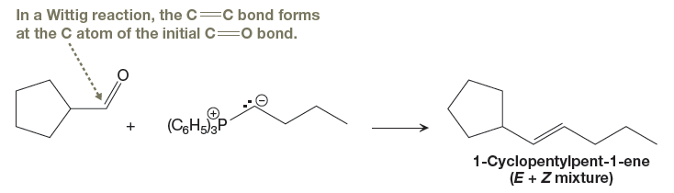
Synthesizing Alkenes: Wittig Reactions Are Better
Notes:
Jmk: I added this slide. Please add Equation 17-52 from p. 850.

Slide 26
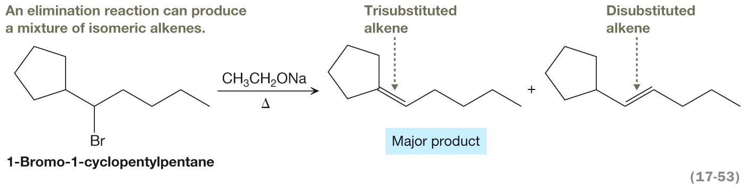
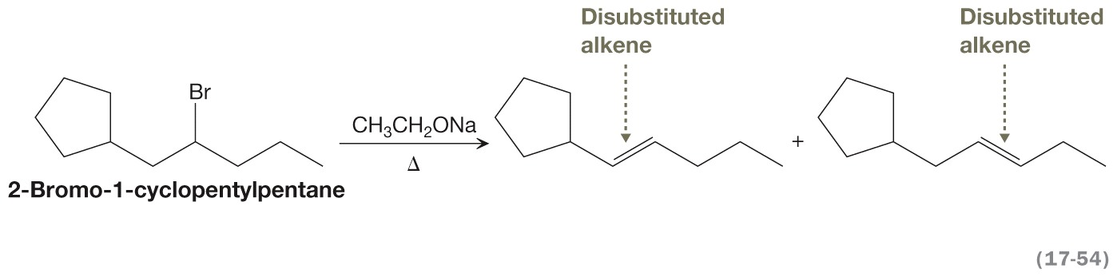
Synthesizing Alkenes: Wittig Reactions Are Better

