Slide 1
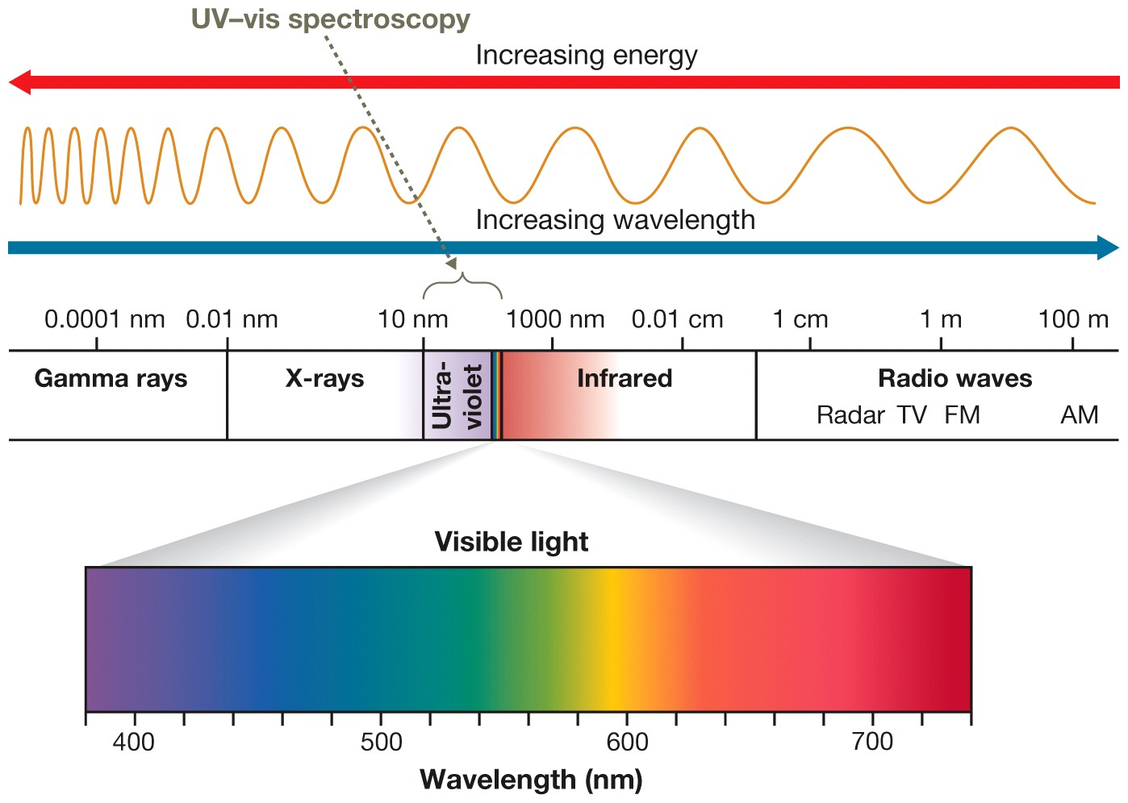
Ultraviolet–visible spectroscopy (UV-Vis)

Slide 2
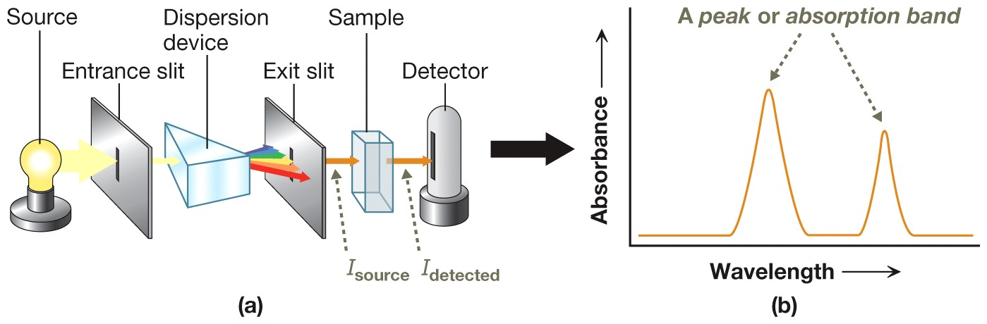
UV-Vis Spectrometer & Spectrum

Slide 3
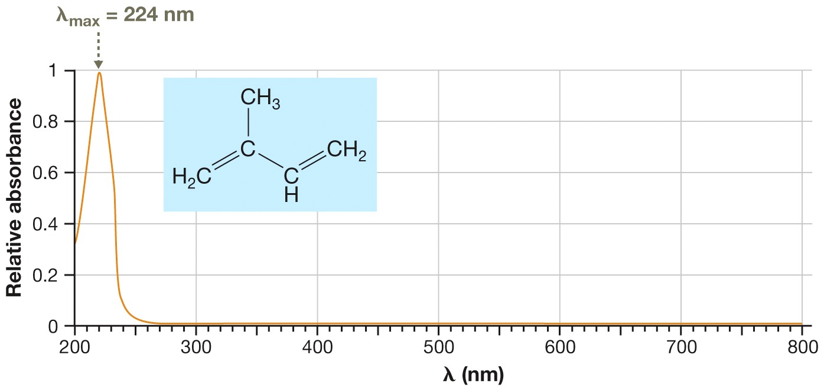
The UV–Vis Spectrum: Photon Absorption and Electron Transitions
Notice that there is a peak (the λ_{max}) in the spectrum, centered at 224 nm.

Slide 4
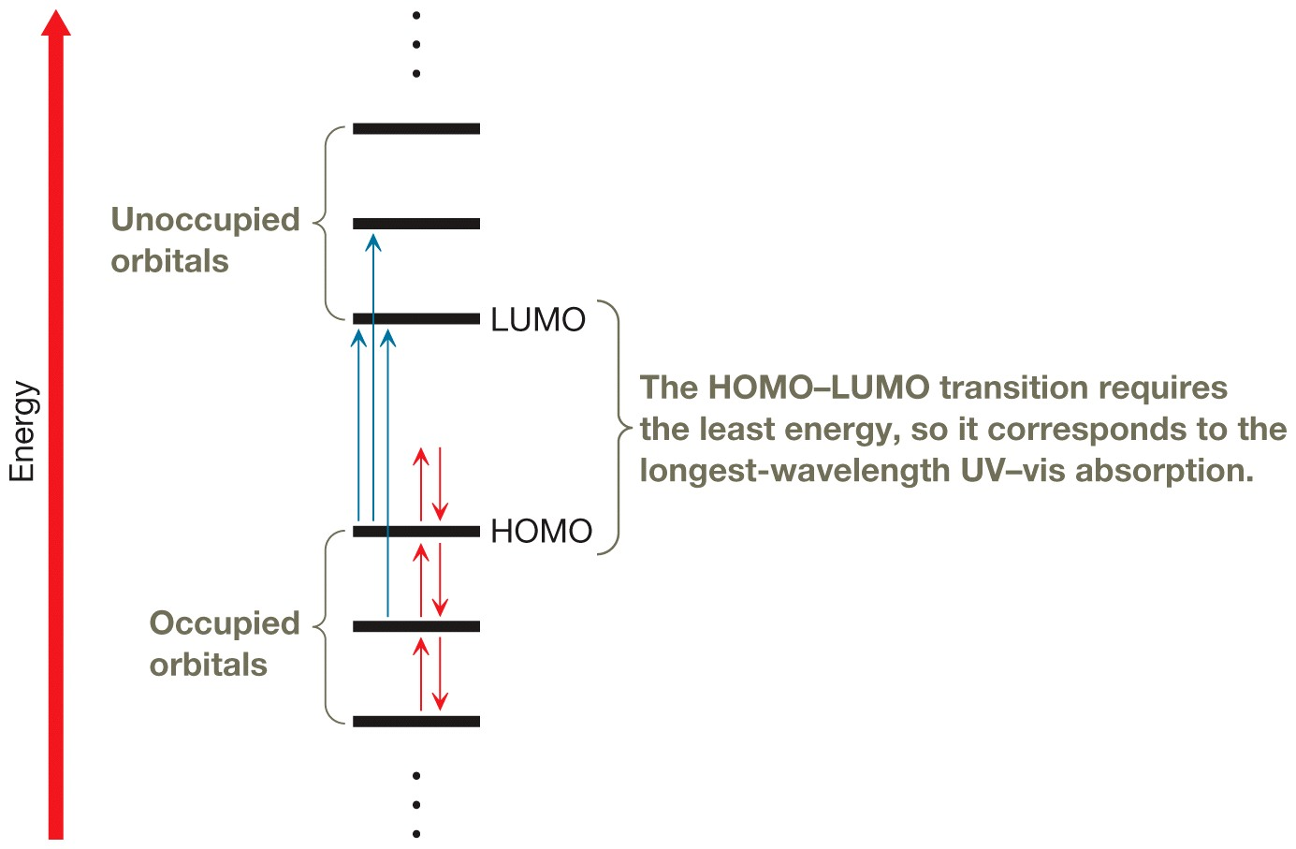
Electronic Transitions in UV-Vis Spectroscopy

Slide 5
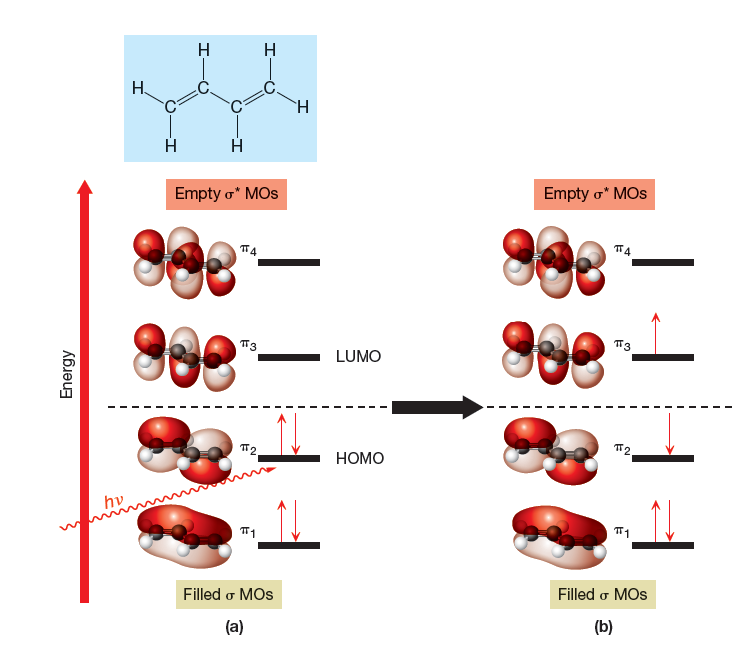
The HOMO-LUMO Transition in Buta-1,3-diene

Slide 6
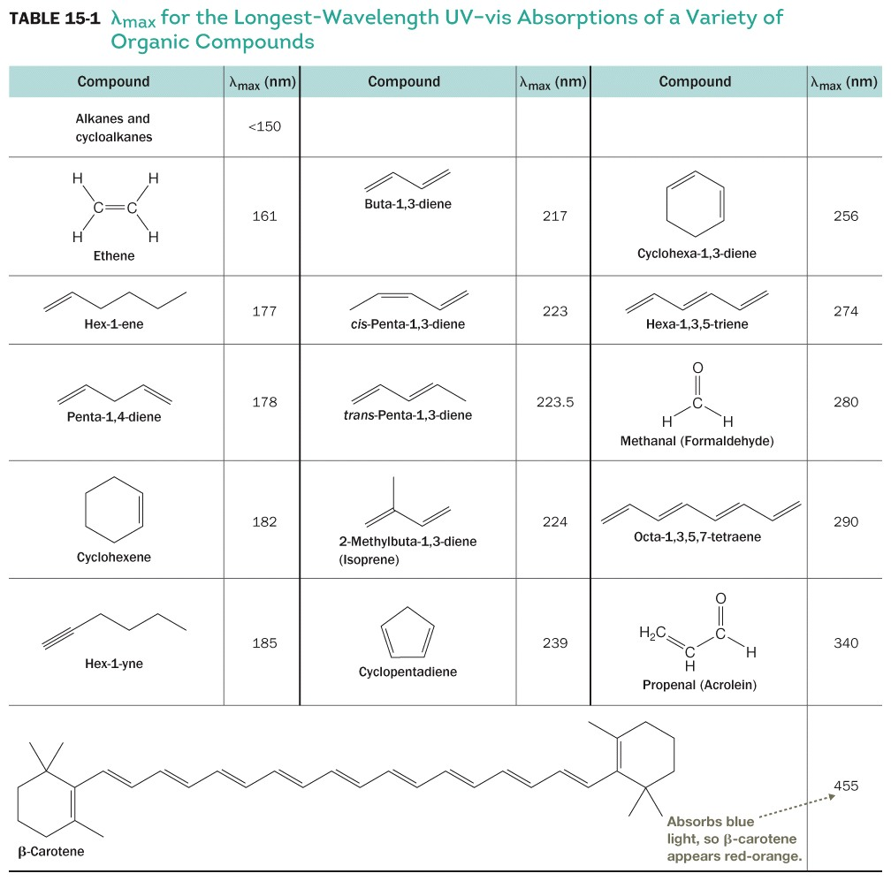
Effects of Structure on λ_{max}

Slide 7
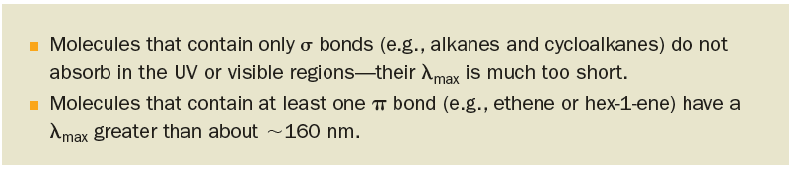
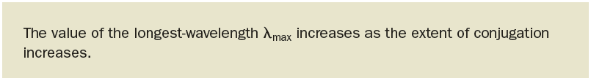
UV-Vis Absorption

Slide 8
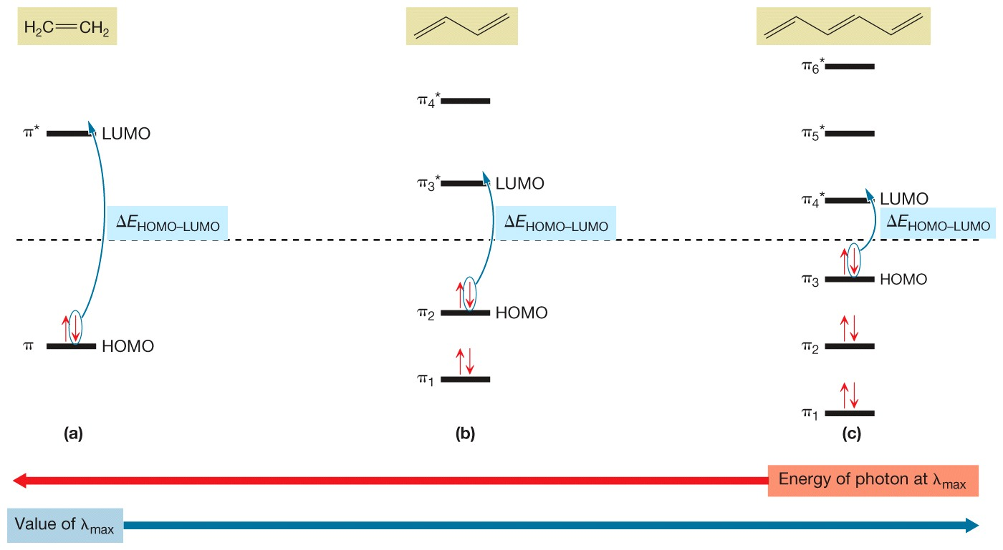
Effect of Conjugation on λ_{max}
As conjugation increases, λ_{max} for the longest-wavelength absorption increases, too.

Slide 9
UV-Vis and Conjugation

Slide 10
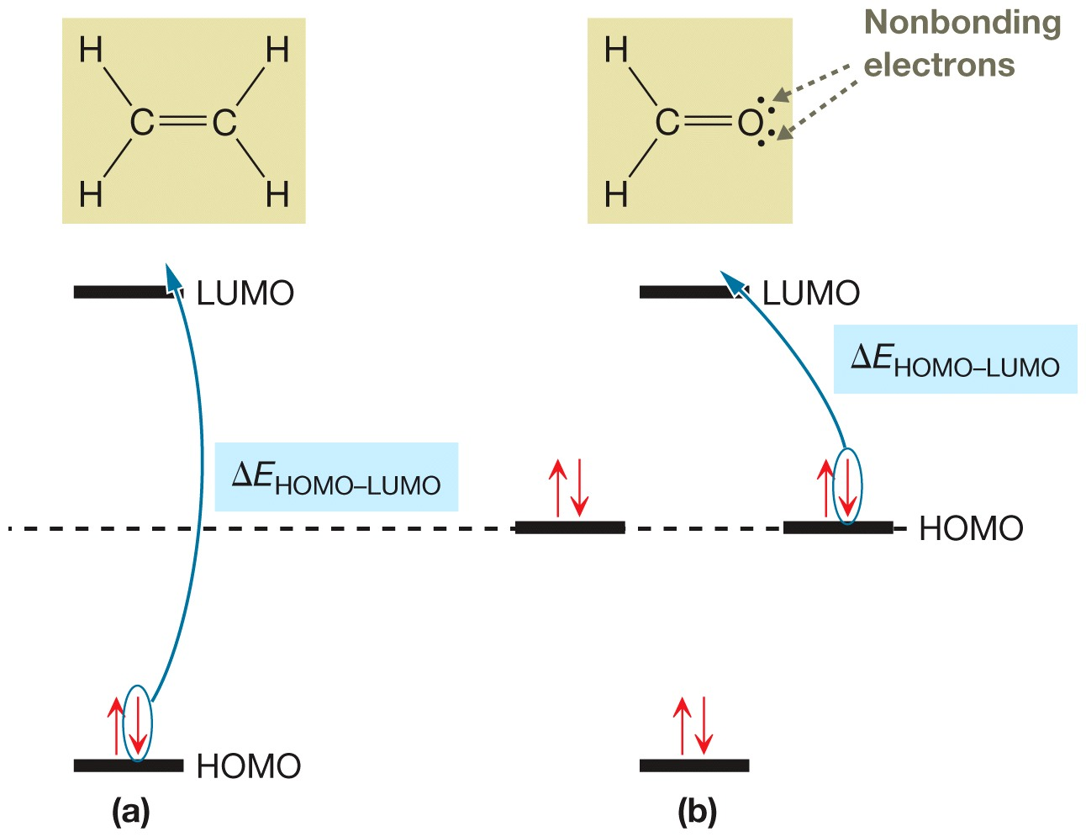
Effect of Lone Pairs on λ_{max}

