Slide 1
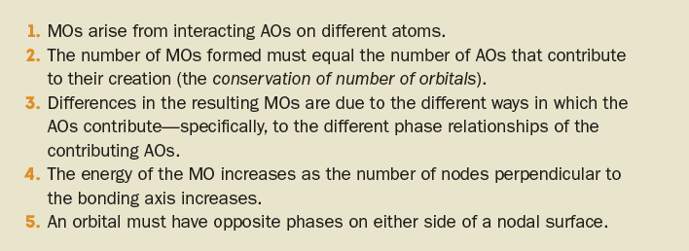
Multiple-Center MO Theory
Like all MOs, the following general rules apply to multiple-center MOs:

Slide 2
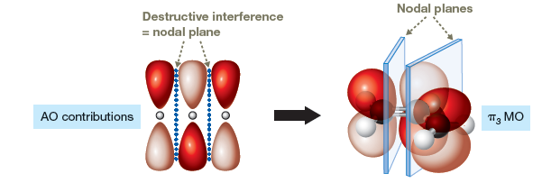
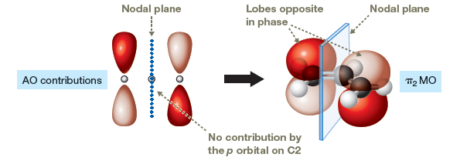
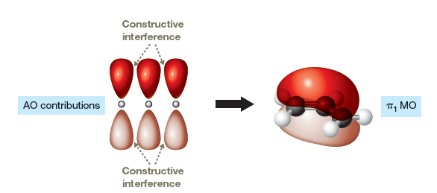
Multiple-Center π MOs of the Allyl Cation

Slide 3
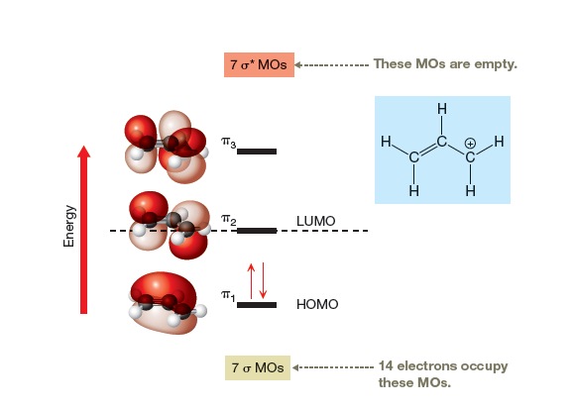
Complete MO Energy Diagram of the Allyl Cation

Slide 4
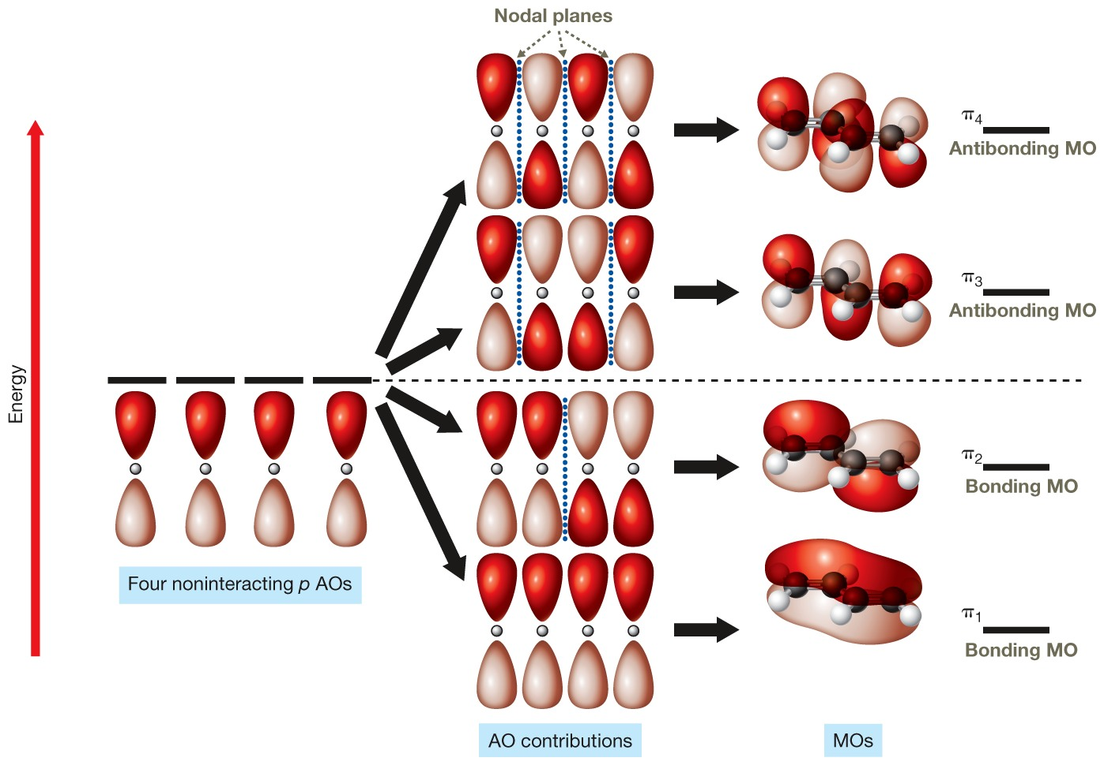
Buta-1,3-diene MOs

Slide 5
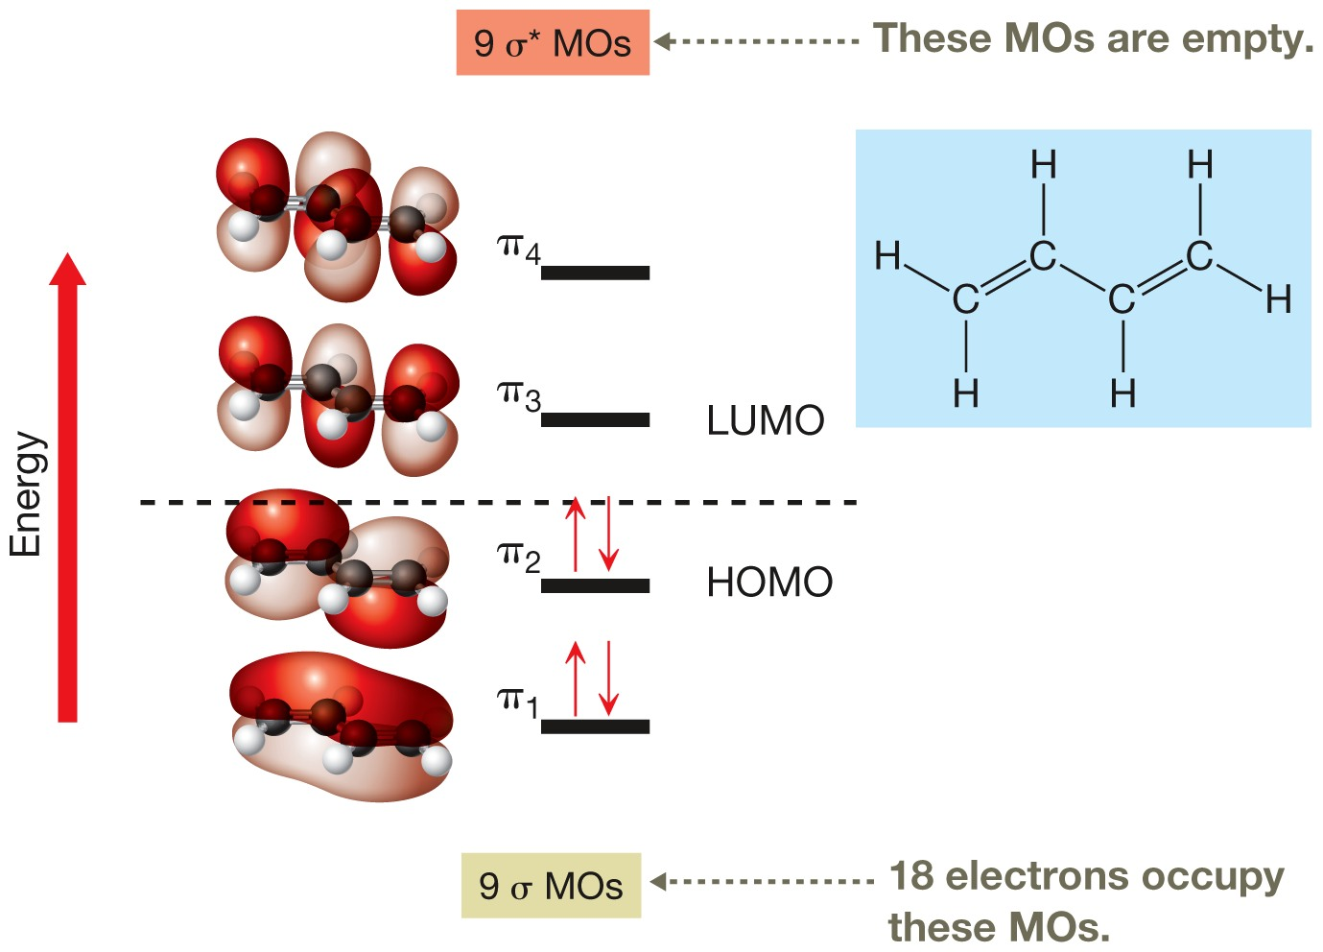
Complete MO Energy Diagram of Buta-1,3-diene

Slide 6
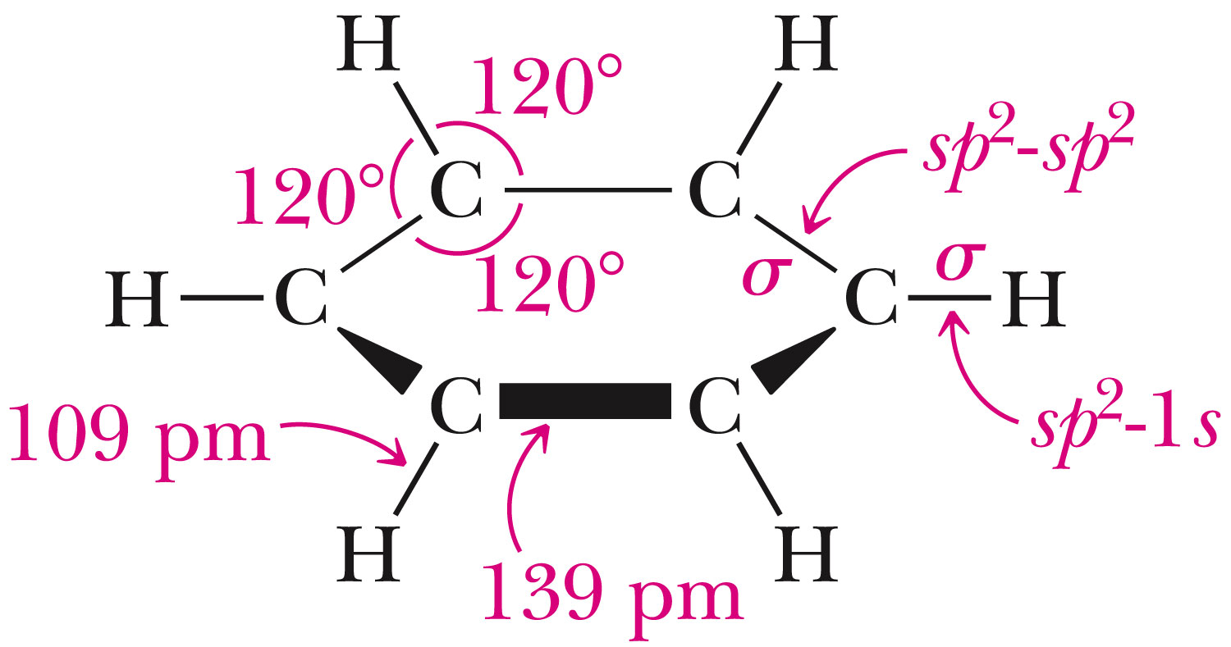
Benzene Structure

Slide 7
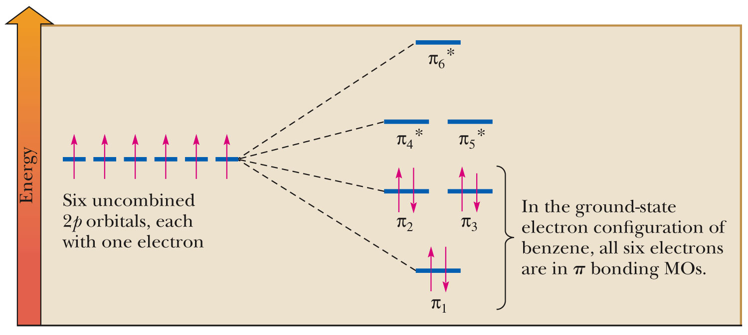
Benzene MOs
Fig. 21-2, p. 855

Slide 8
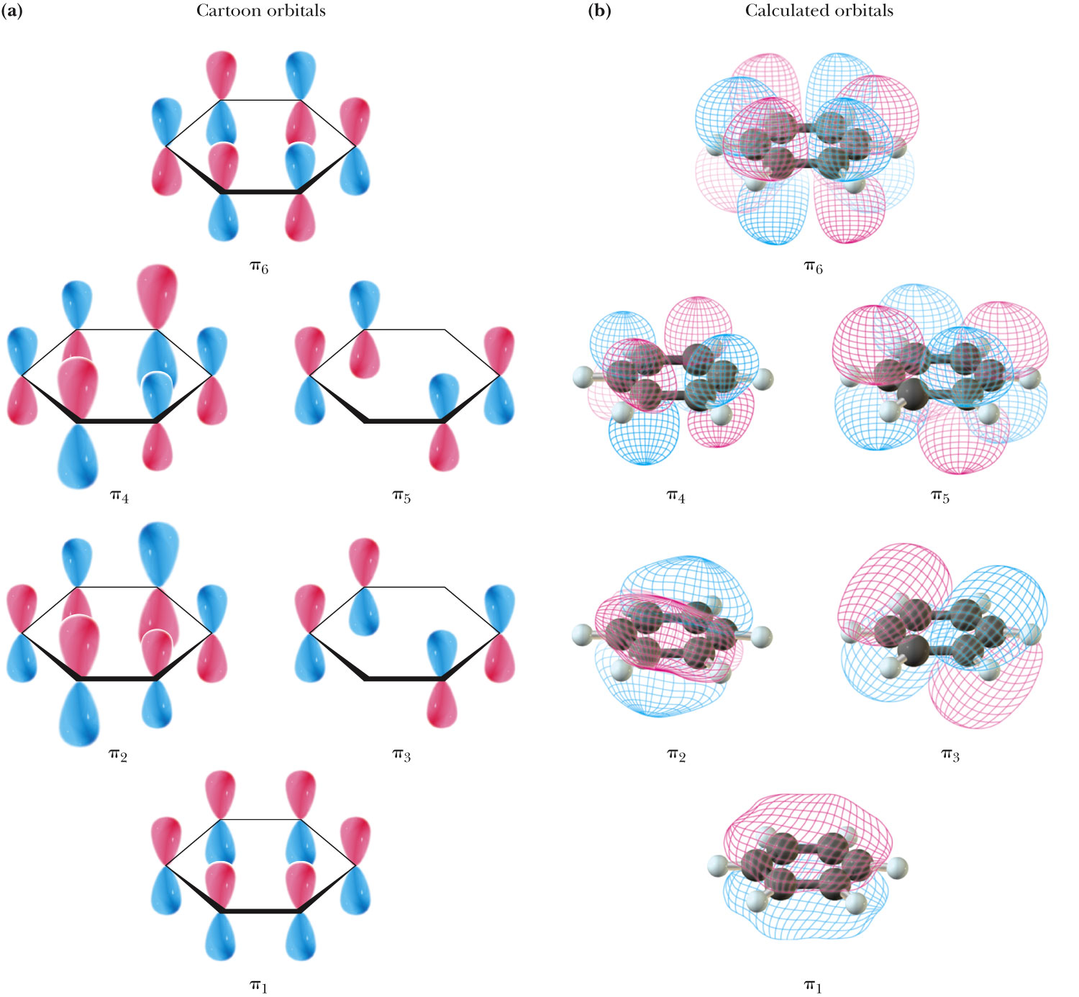
Benzene MO Diagram
Fig. 21-3, p. 856

Slide 9
Heats of Hydrogenation

Slide 10
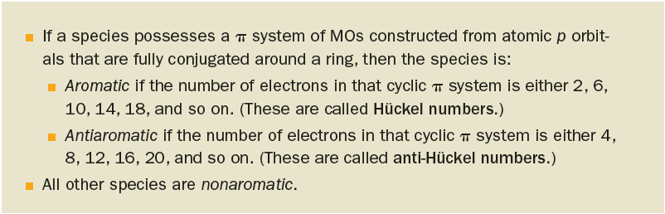
Hückel Rules
From his observations on the structural similarities of compounds in each of these classes, Erich Hückel (1896–1980), a German physicist and physical chemist, proposed what are now known as the Hückel rules for aromaticity:
Alternatively, the Hückel numbers correspond to 4n + 2, where n is any integer >0, and the anti-Hückel numbers correspond to 4n, where n is any integer >1.

Slide 11
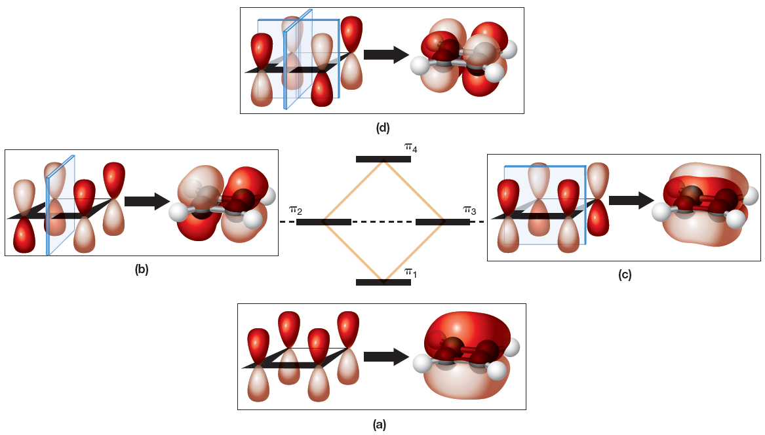
Cyclobutadiene’s π Mos
The lowest-energy MO (π₁) has no nodal planes perpendicular to the bonding axes, and each additional nodal plane raises the energy of the other MOs.

Slide 12
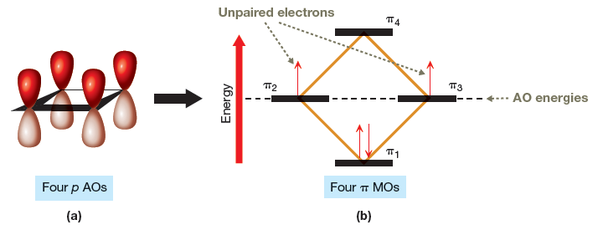
MO Picture of Cyclobutadiene

Slide 13
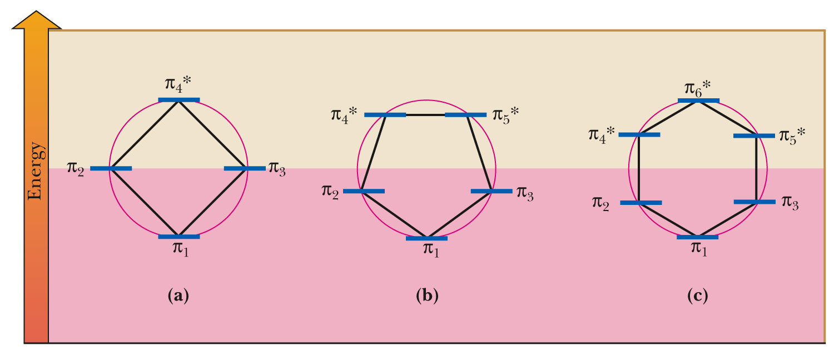
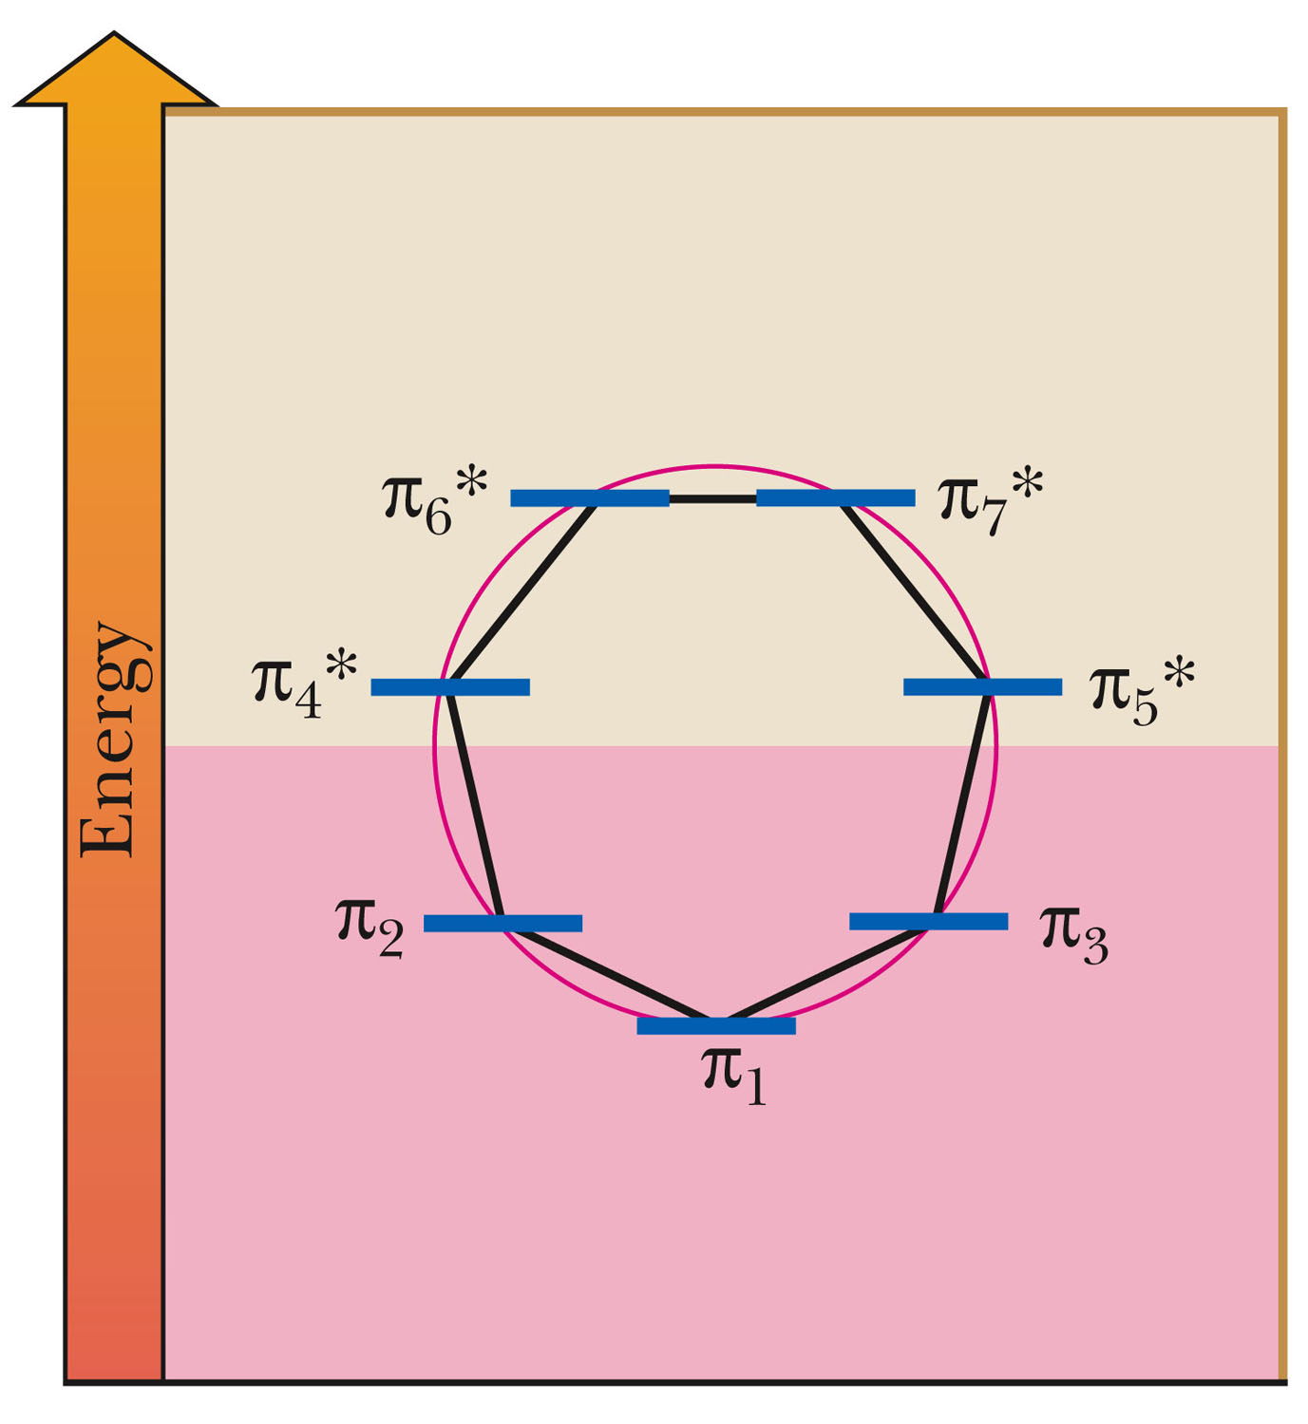
Fig. 21-6, p. 859

Slide 14
Aromatic Hydrocarbon: A cyclic, planar, fully conjugated hydrocarbon with 4n+2 pi electrons (2, 6, 10, 14, 18, etc).
    An aromatic hydrocarbon is especially stable relative to an open-chain fully conjugated hydrocarbon of the same number of carbon atoms.
Nonaromatic Hydrocarbon: A cyclic, non-planar, fully conjugated hydrocarbon with 4n+2 pi electrons.
    A nonaromatic hydrocarbon has similar stability to its open-chain fully conjugated hydrocarbon of the same number of carbon atoms.
Antiaromatic hydrocarbon: A monocyclic, planar, fully conjugated hydrocarbon with 4n pi electrons (4, 8, 12, 16, 20...).
  An antiaromatic hydrocarbon is especially unstable relative to an open-chain fully conjugated hydrocarbon of the same number of carbon atoms.

Slide 15
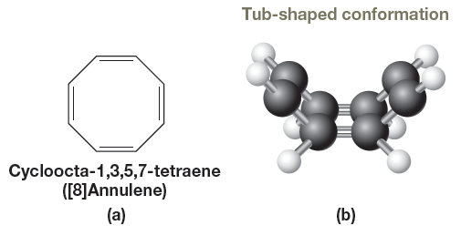
Cycloocta-1,3,5,7-tetraene
According to Hückel’s rules, [8]annulene should be antiaromatic if it is planar.
Because of the instability associated with antiaromaticity, however, [8]annulene resists planarity.

Slide 16
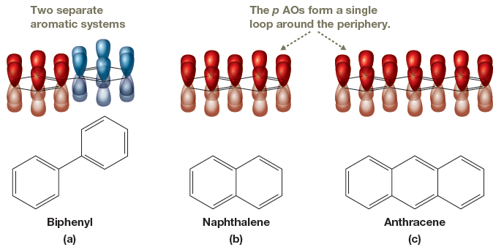
Aromaticity and Multiple Rings
Compounds with two or more rings can also be aromatic.
These molecules are aromatic, and as a class are called polycyclic aromatic hydrocarbons (PAHs).

Slide 17
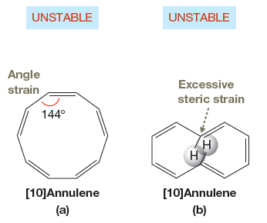
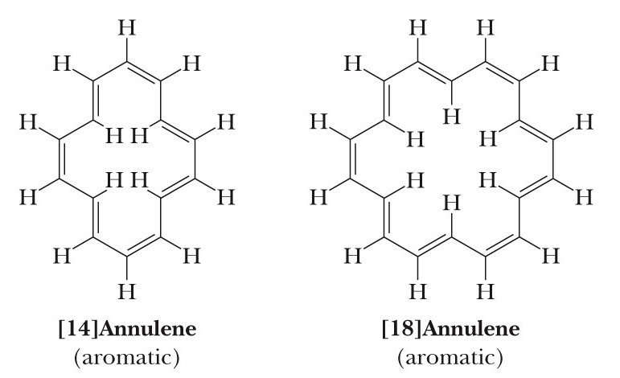
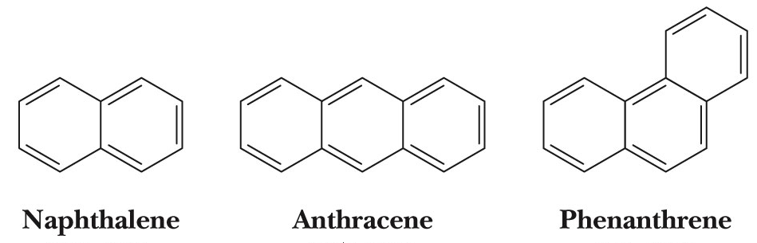
Other Aromatics

Slide 18
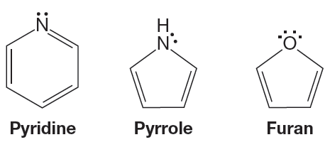
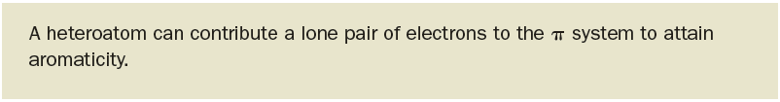
Heterocyclic Aromatic Compounds
Heterocyclic aromatic compounds include pyridine, pyrrole, and furan.

Slide 19
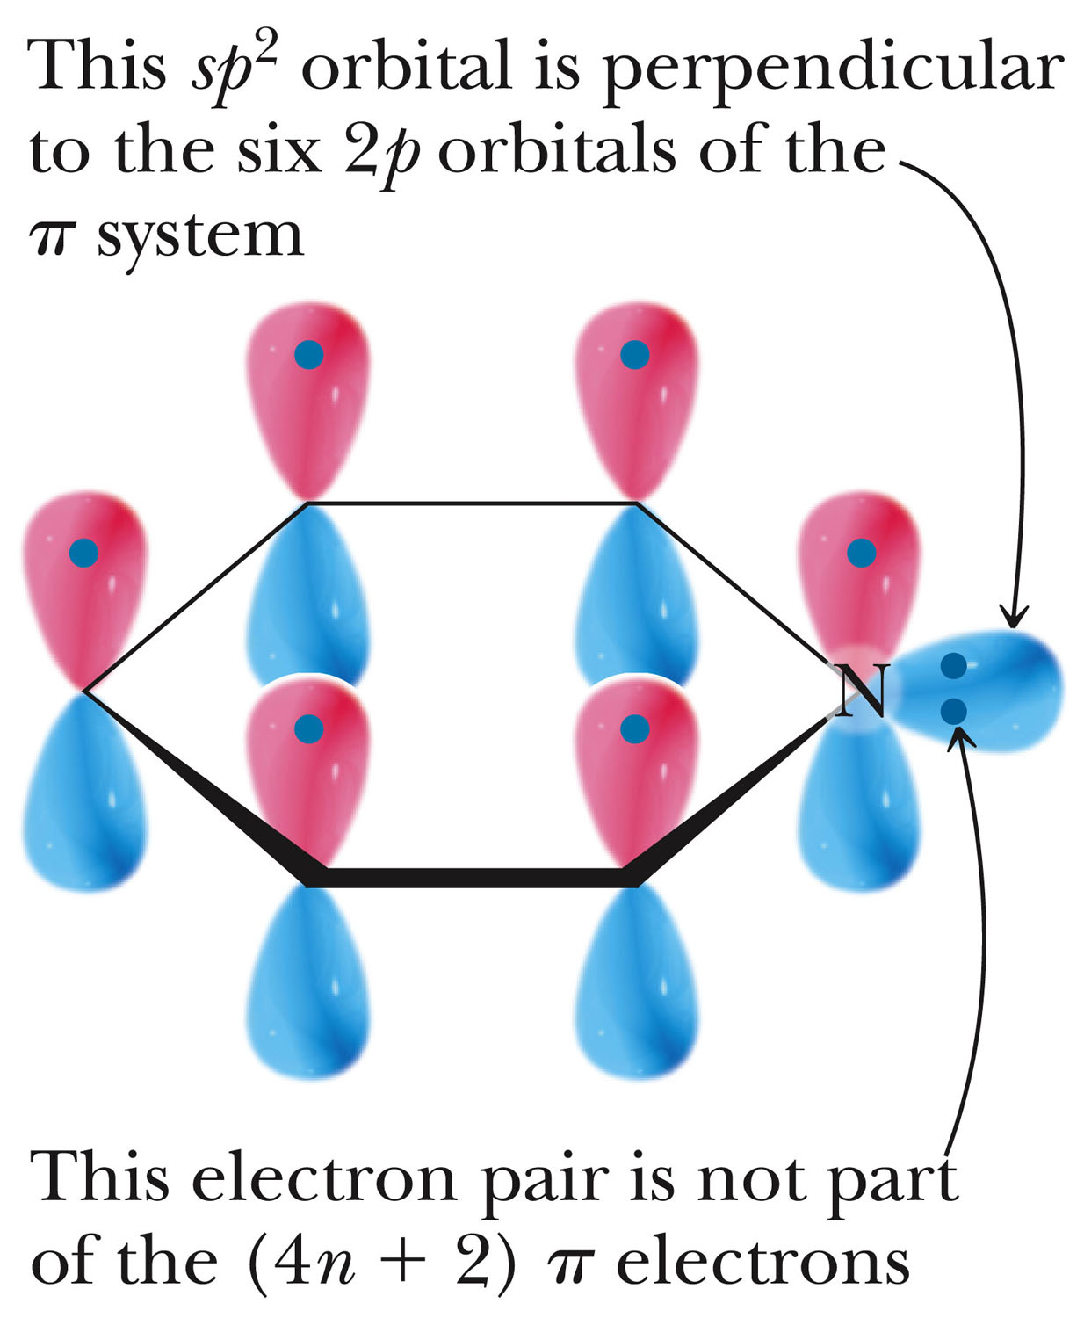
Fig. 21-10, p. 864

Slide 20
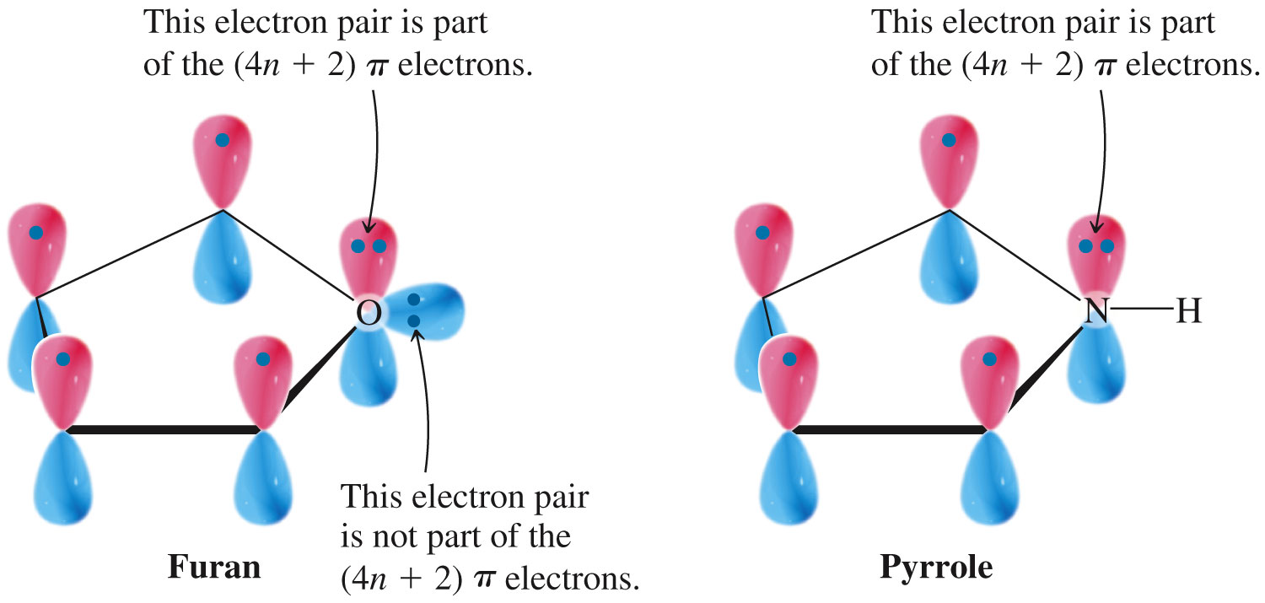
Fig. 21-11, p. 864

Slide 21
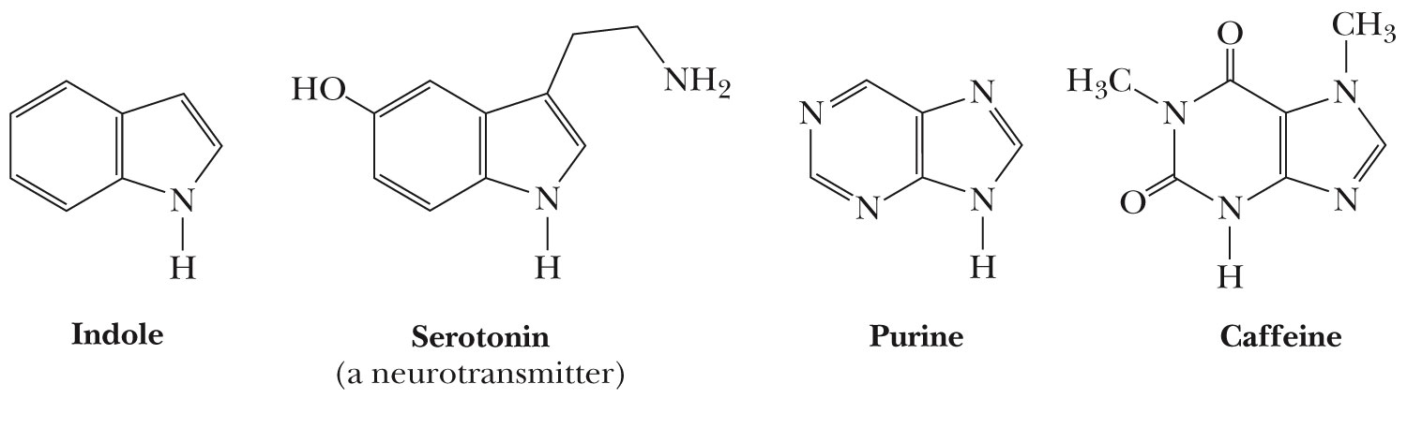
Biologically Relevant Heterocycles
p. 864

Slide 22
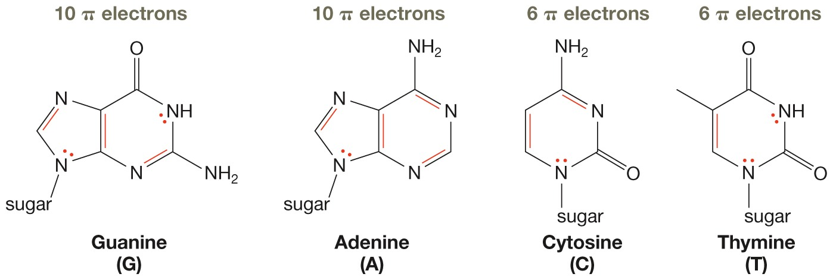
Aromaticity and DNA
Aromaticity affects the structure and properties DNA.

