Slide 1
Organic Synthesis
A synthesis is a specific sequence of chemical reactions that converts starting materials into the desired compound, called the target of the synthesis (or the synthetic target).
A synthesis is often the culmination of several separate reactions, which are called synthetic steps.
Often a synthesis is necessary to produce a natural product when the demand for the compound outweighs nature’s supply.
Syntheses are also used to produce new compounds that are not produced by nature.

Slide 2
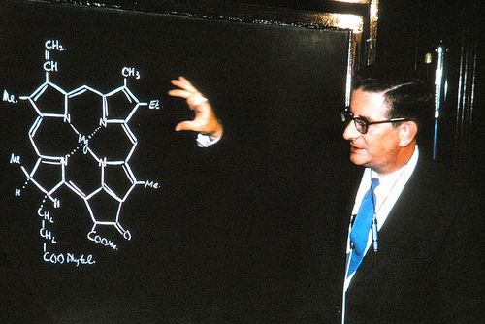
R.B. Woodward (1917-1979)
1st modern synthetic organic chemist
Probably greatest organic chemist
1965 Nobel Prize in Chemistry
  “outstanding achievements in the art of organic synthesis
Also made VERY important observations in the development of the Woodward-Hoffman rules of ring closure
  1st step in the application of quantum mechanics to organic molecules
  1981 Nobel Prize in Chemistry (Roald Hoffmann)

Slide 3
R.B. Woodward (Early Career)

Slide 4
R.B. Woodward (Later Career)

Slide 5
R.B. Woodward

Slide 6

K.C. Nicolaou
Penn (1977-1989)
Scripps Research Institute and UC-San Diego (1989-present)
Modern day R.B. Woodward

Slide 7

K.C. Nicolaou
Taxol
Isolated in 1967 from bark of Pacific yew tree
Lung, ovarian, breast, head and neck cancer
11 stereocenters => 2¹¹ = 2048 stereoisomers
2 rings & 1 bicyclic ring

Slide 8
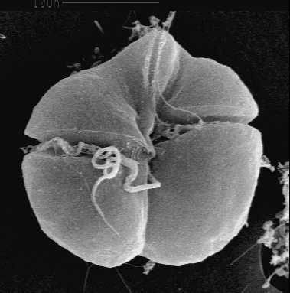
K.C. Nicolaou
Brevotoxin B
Neurotoxin that binds to voltage-gated sodium channels in nerve cells
Naturally found in Karenia brevis which are marine organisms typically found in fish
23 stereocenters => 2²³ = 8,400,000 stereoisomers
11 trans-fused rings
83 steps, 12 years
91% yield for each step but 0.043% total yield

Slide 9
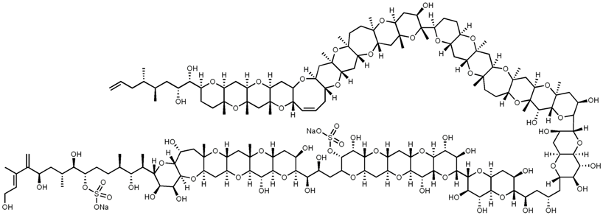
K.C. Nicolaou
Maitotoxin
Neurotoxin that binds to calcium channels
Naturally produced by Gambierdiscus toxicus which are marine organisms typically found in fish
94 stereocenters => 2⁹⁴ = 1.98 x 10²⁸ stereoisomers
31 trans-fused rings

Slide 10
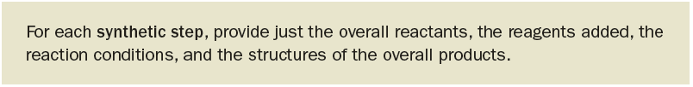
Writing the Reactions of an Organic Synthesis
There are essentially three main conventions routinely used in writing a synthetic scheme.
The first stems from the fact that a synthesis is an abbreviated recipe.

Slide 11
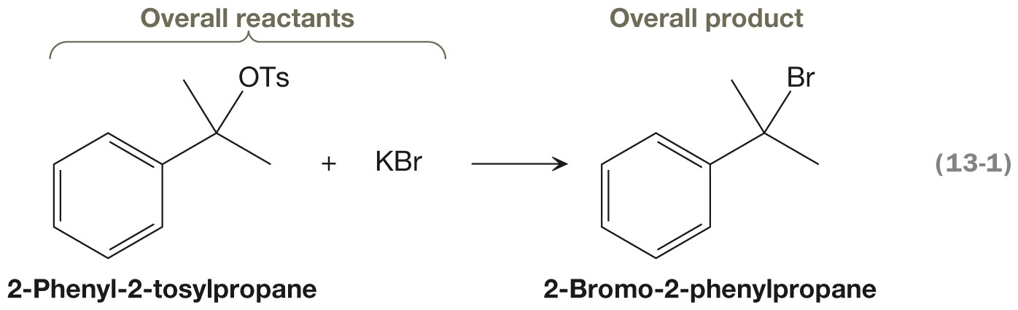
Example of a Synthetic Step
This synthetic step shows how to convert 2-phenyl-2-tosylpropane into 2-bromo-2-phenylpropane.
Notice that it does not show the individual elementary steps.
  It doe not contain curved arrows, nor does it contain reactive intermediates.
Notes:
.

Slide 12
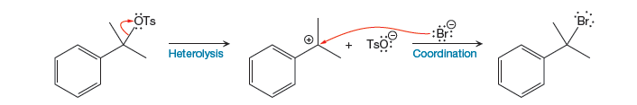
Example of a Mechanism
This is the mechanism for the previous synthetic step.
  It is composed of elementary steps.
  It contains curved arrows and reactive intermediates.

Slide 13
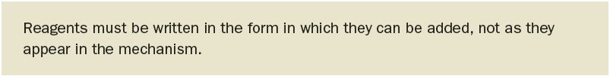
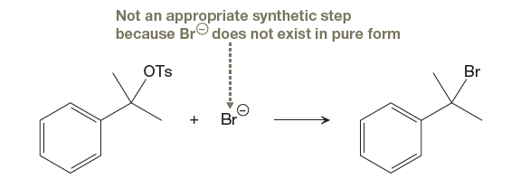
Example of a an Incorrect Synthetic Step
This proposed synthetic step, therefore, is technically incorrect because Br⁻ cannot be added in pure form.

Slide 14

Common Simplifications to Synthetic Steps
Notice, for example, that TsO⁻ was not included in this synthetic step.

Slide 15
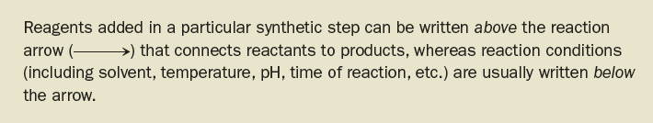
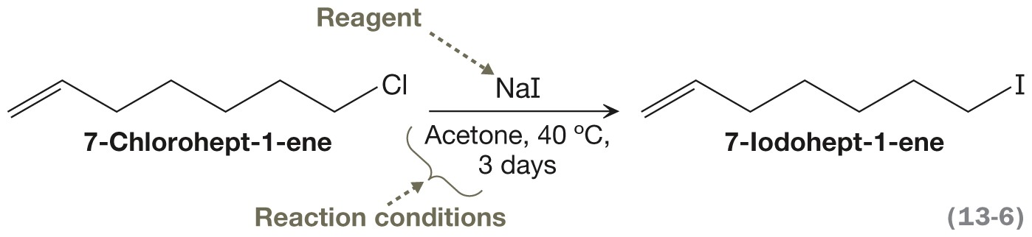
Reagents versus Reaction Conditions
Notes:
Jmk: I changed the title. I deleted the yellow box and added it earlier. It didn’t belong here…made no sense. I also deleted the bullet. Please add the yellow box from the bottom of p. 648 to the top of this slide (the box beginning “Reagents added…”
Insert eq 13-6 here
Insert first yellow text box pg 5
06_p648_Karty1_CH13
p647_Karty1_CH13_yellow text box

Slide 16
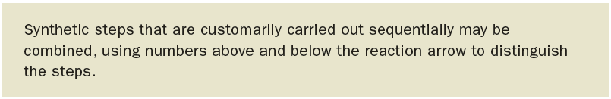
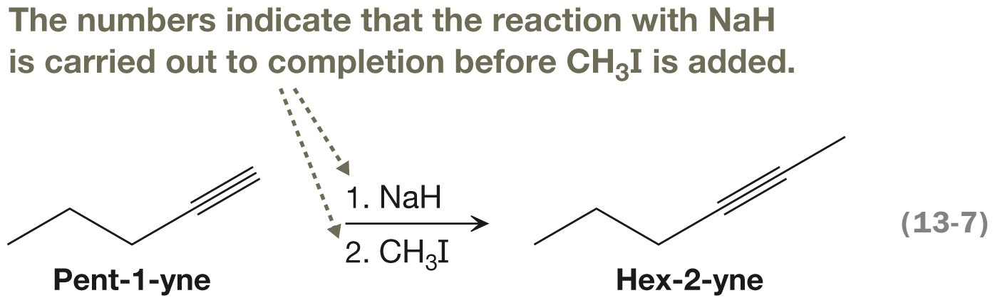
Combining Separate Reactions

Slide 17
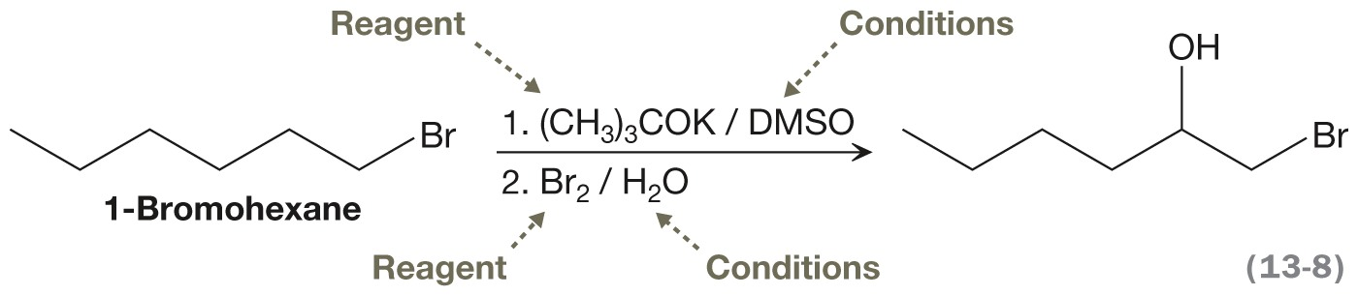
More Information in Scheme
Using this convention for sequential steps, reaction conditions can be written after the reagent for each numbered step.
The reaction conditions are typically separated from the reactant or reagent by either a comma or by a slash.

Slide 18
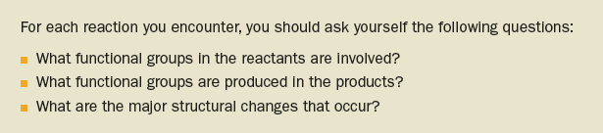
Cataloging Reactions
There are two major types of reactions
  Functional group transformations, which only convert one functional group into another without affecting the carbon skeleton.
  Reactions that result in the formation and/or breaking of a C–C σ bond.

Slide 19
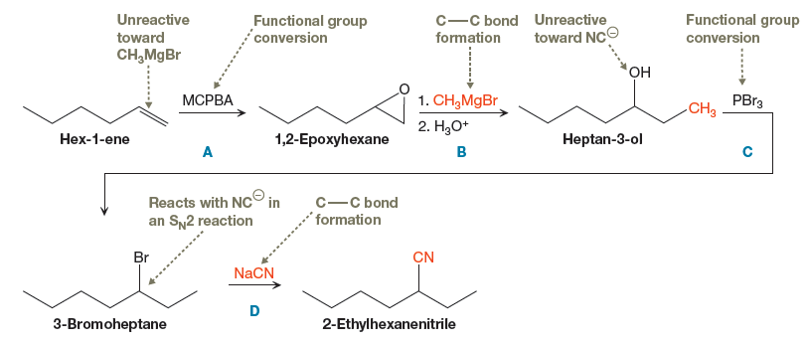
Cataloging Reactions continued…

Slide 20
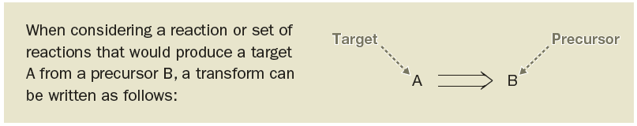
Retrosynthetic Analysis:
Elias J. Corey (1928–) of Harvard University pioneered a new method of designing a synthesis scheme, called retrosynthetic analysis.
The basis of retrosynthetic analysis is the transform, which is the proposed undoing of a single reaction or set of reactions.
An open arrow, called a retrosynthetic arrow, is the convention used to indicate a transform, and is drawn from the target to the precursor.

Slide 21
The Strategy of Organic Synthesis
Retrosynthetic Analysis:
work backwards
desired compound target
new target (simpler)
What can I make
the target from?
repeat
repeat
available compound
Notes:
A common problem that an organic chemist faces is the preparation of a compound that is not available from a commercial source. Perhaps the compound is needed to test as a new pharmaceutical, or to make a new plastic. First we check the chemical literature to see if anyone has ever made it. If not, then we have to design a way to make it. Organic Synthesis. We do not begin by picking a compound and trying to figure out how to convert it to the desired compound. Instead, we look at the desired compound and see what simpler compound we can make it from.
Because you do not know what is likely to be available, we will specify what you are to start with in some manner.

Slide 22
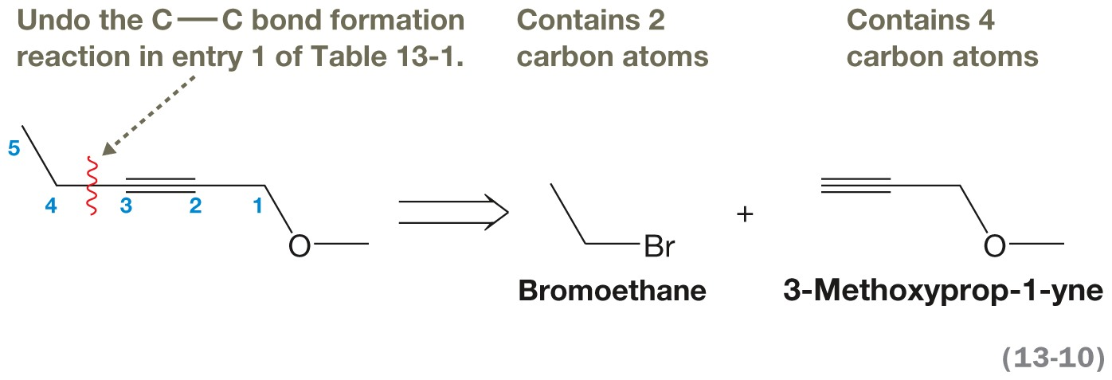
Example of a Retrosynthetic Analysis
How can we synthesize 1-methoxypent-2-yne from precursors containing three or fewer carbon atoms?
The C3–C4 bond 1-Methoxypent-2-yne is disconnected.
Of those two precursors, only bromoethane is acceptable for our starting material, because it contains three or fewer C atoms.

Slide 23
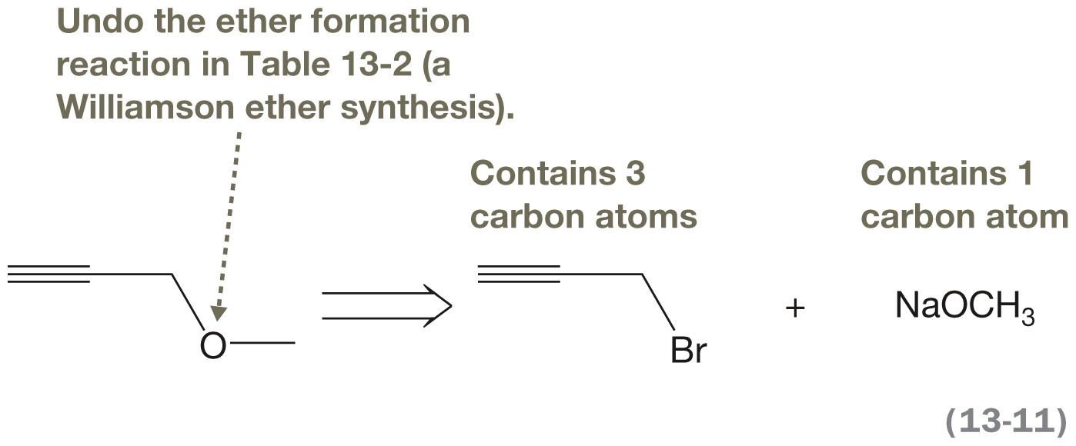
Example of a Retrosynthetic Analysis continued…
3-Methoxyprop-1-yne contains four C atoms, however, so it cannot be used as starting material.
One must apply a transform to dissect it into smaller precursors. 3-Methyoxyprop-1-yne contains an ether functional group, so we can apply a transform that undoes an ether-forming reaction.

Slide 24
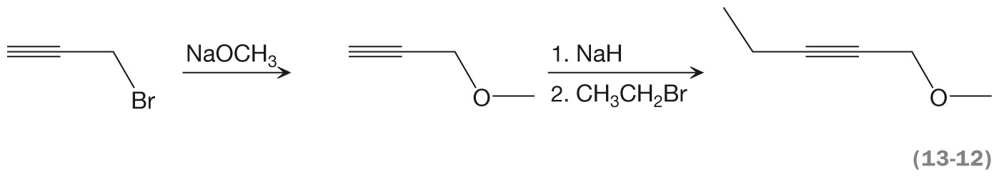
The Complete Synthesis for 1-Methoxypent-2-yne
Both of these precursors now contain three or fewer carbons and can be used as starting materials.
What remains to complete the synthesis is to reverse the transforms and to include the necessary reagents and conditions that will accomplish each reaction.

Slide 25
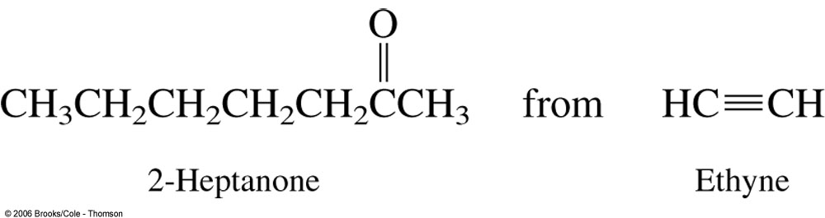
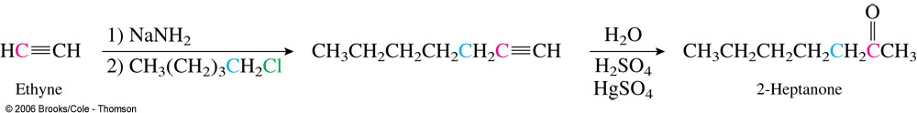
Retrosynthetic Analysis Examples
Notes:
Recall that the best way to approach a synthesis is to work backward from the desired compound: retrosynthetic analysis.
Remember, C-C bond forming reactions are very important.

Slide 26
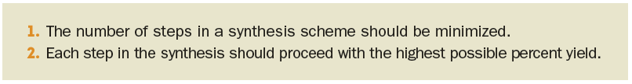
Percent Yield
To minimize the costs of a synthesis and to help make the synthesis as green as possible, the percent yield of the target should be maximized.

Slide 27
Linear Synthesis
These rules are essentially an outcome of how percent yield is computed for a linear synthesis (i.e., a synthesis composed of sequential steps)
For a linear synthesis, the overall percent yield is equal to the product of the yields of the individual steps.

Slide 28
Linear Synthesis continued…
Consider two syntheses, one with three synthetic steps and the second with six synthetic steps.
If both syntheses proceeds with an 80% yield of product for each step, what would be the overall yield for each?
The three-step synthesis will have an overall yield of (0.80) x (0.80) x (0.80) = (0.80)³ = 0.51, or 51%.
The six-step synthesis will have an overall yield of 26%.
The synthesis with the fewer number of steps has the greater yield.

Slide 29
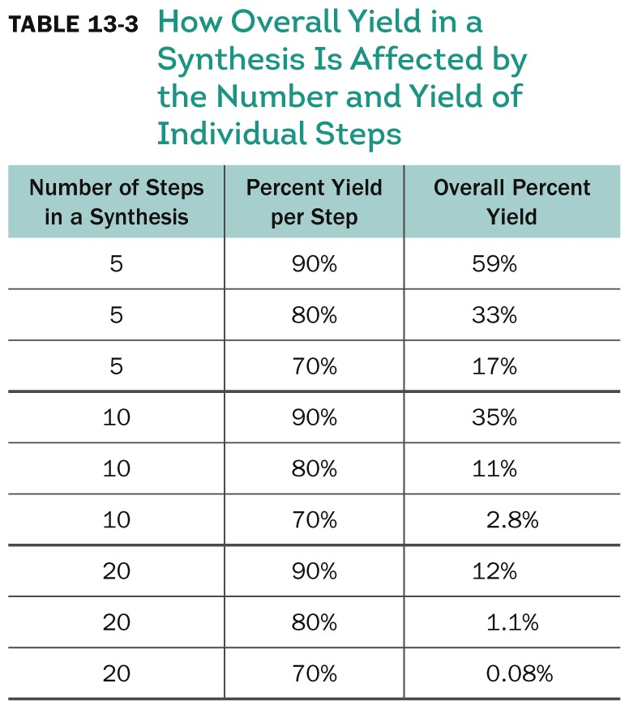
Overall Yield and Number of Steps

Slide 30
Convergent Synthesis
In a convergent synthesis, portions of a target molecule are synthesized separately and are assembled together at a later stage.
The yield can generally be improved.

Slide 31
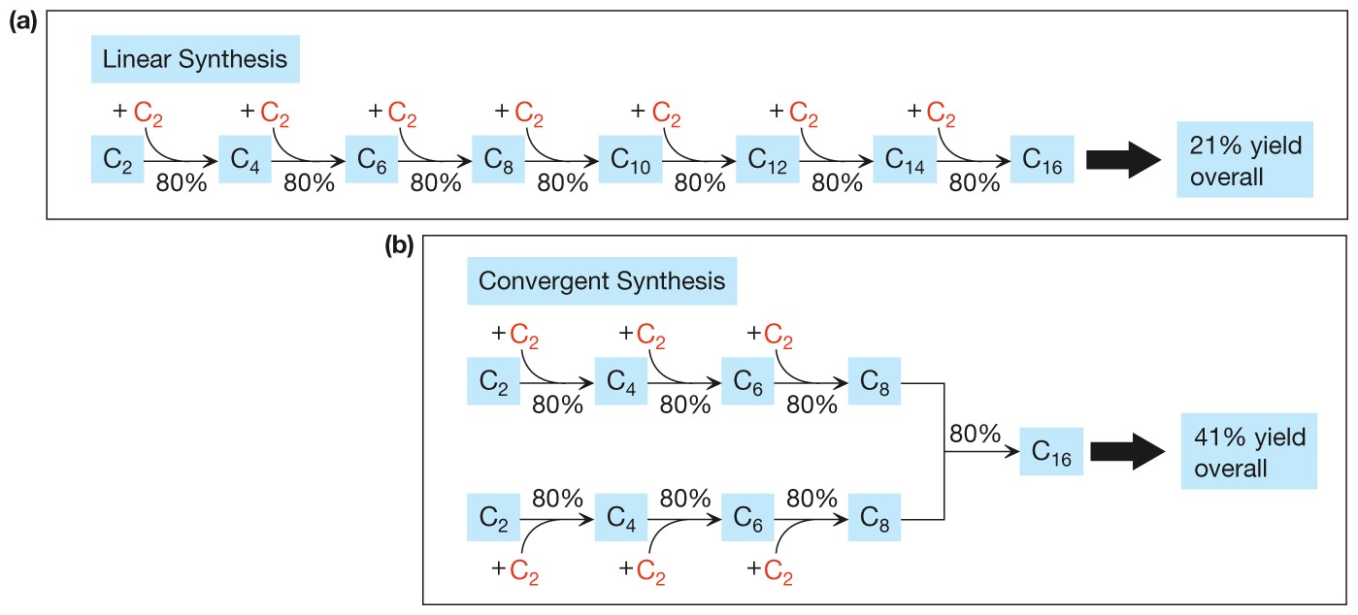
Linear versus Convergent Synthesis

Slide 32
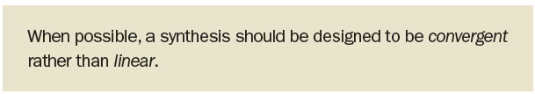
Best Choice: Convergent
The better yield often obtained from a convergent synthesis leads to the following general rule:

Slide 33
Problems
Notes:
A common problem that an organic chemist faces is the preparation of a compound that is not available from a commercial source. Perhaps the compound is needed to test as a new pharmaceutical, or to make a new plastic. First we check the chemical literature to see if anyone has ever made it. If not, then we have to design a way to make it. Organic Synthesis. We do not begin by picking a compound and trying to figure out how to convert it to the desired compound. Instead, we look at the desired compound and see what simpler compound we can make it from.
Because you do not know what is likely to be available, we will specify what you are to start with in some manner.

