Slide 1
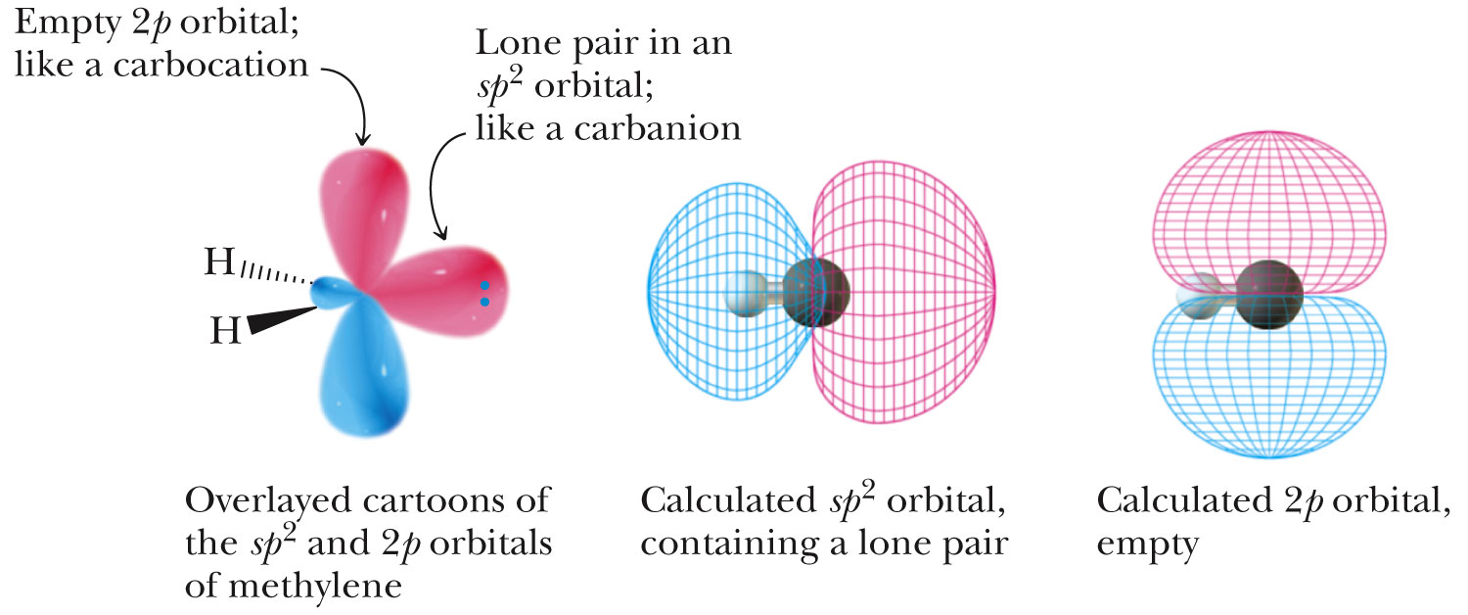
Carbene
In its lowest electronic state, carbon is sp² hybridized with the unshared pair of electrons occupying the third sp² orbital.

Slide 2
Dihalocarbene

Slide 3
Bromination
Green Principles Addresses
  Less Hazardous Reagents
  Safer Solvent
  Use of Renewable Feedstocks

Slide 4
