Slide 1
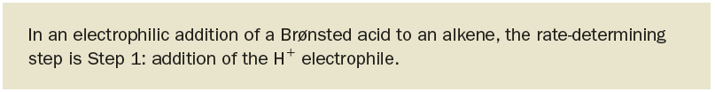
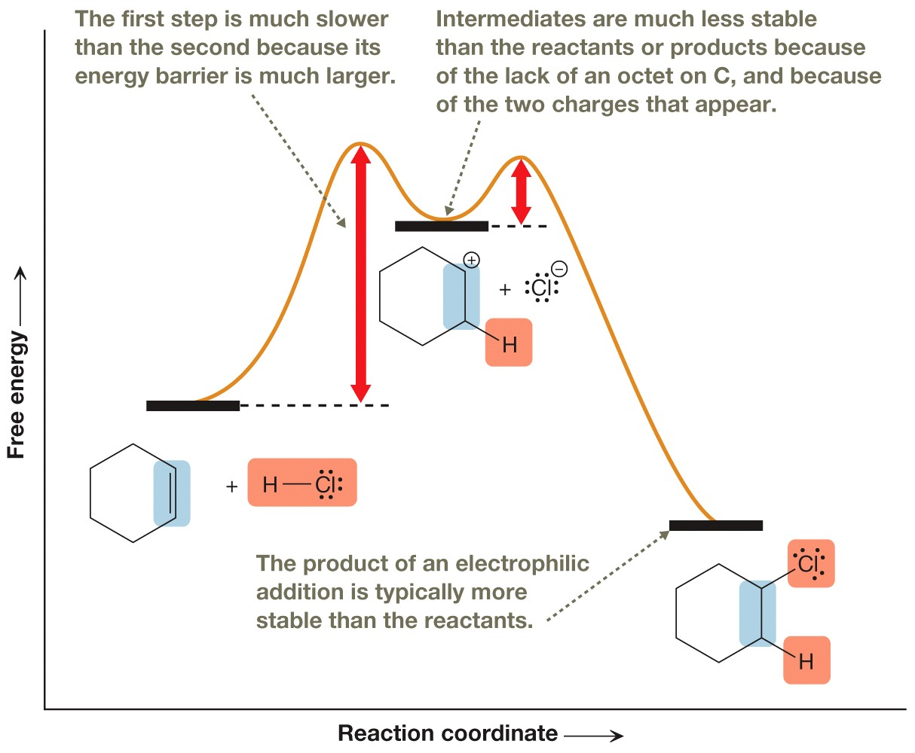
Rate Determining Step

Slide 2
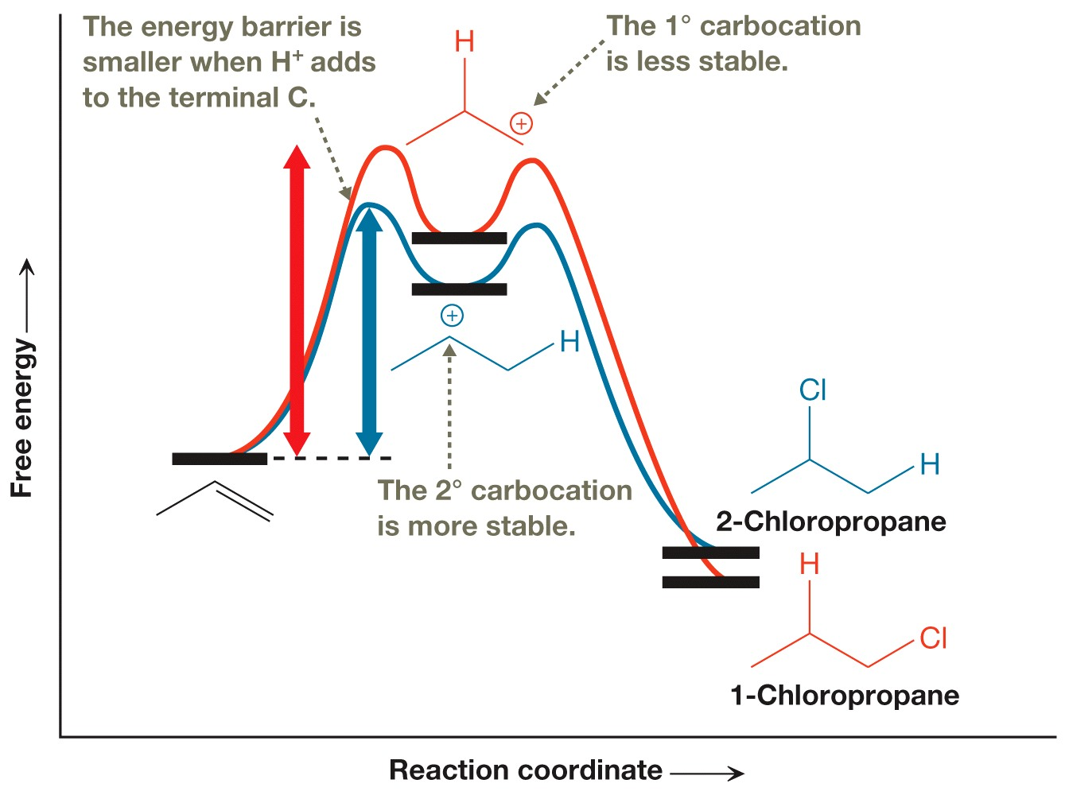
Mechanistic Explanation of Markovnikov’s Rule continued…

Slide 3
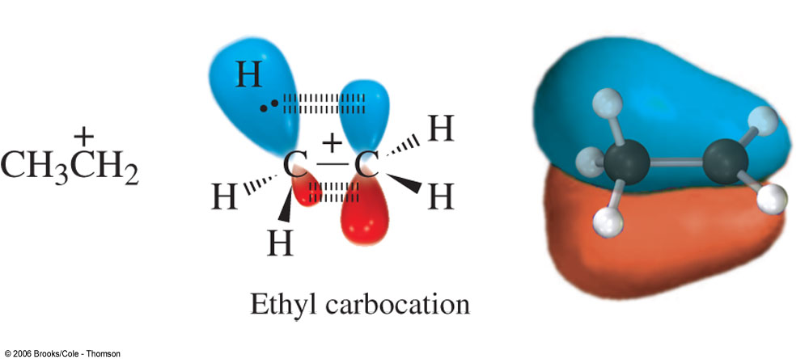
Hyperconjugation
secondary can do 2x, tertiary can do 3x
Notes:
The increased stability of a carbocation as methyl or other groups are added to the C+ is due to hyperconjugation. Conjugation: p orbitals overlap. Hyperconjugation: sigma MO overlaps with p orbital. Coplanar but not parallel, so overlap not as good, stabilization not as much as normal conjugation.

